Slide 1
Communities
Of Faith
Community = ……………………………………
Faith = ……………………………………………..
A community of faith is a group of people who share a particular set of religious beliefs

Slide 2






There are FIVE major religions in the world today.
Each religion has a symbol to represent it…
Islam
Buddhism
Judaism
Hinduism
Christianity

Slide 3
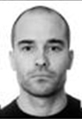
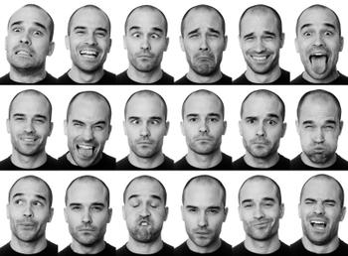
Mono
Poly
…means one!
…means many!

Slide 4
-ism =
Theism =
Monotheism =
Polytheism =

Slide 5
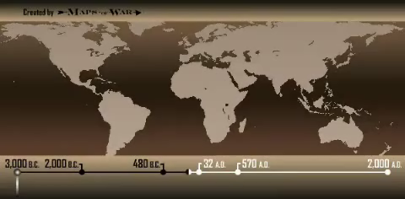

Slide 6

Hinduism
Founder/Leader
When?
Where?
Earliest Followers
Sacred Text
Monotheist/Polytheist

Slide 7
Judaism
Founder/Leader
When?
Where?
Earliest Followers
Sacred Text
Monotheist/Polytheist

Slide 8
Buddhism
Founder/Leader
When?
Where?
Earliest Followers
Sacred Text
Monotheist/Polytheist

Slide 9

Christianity
Founder/Leader
When?
Where?
Earliest Followers
Sacred Text
Monotheist/Polytheist

Slide 10
Islam
Founder/Leader
When?
Where?
Earliest Followers
Sacred Text
Monotheist/Polytheist

