Slide 1
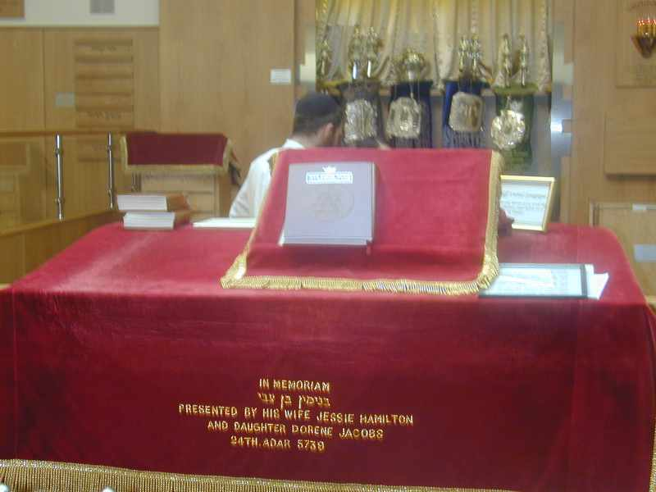
The Synagogue
A Synagogue is a Jewish place of worship. The word Synagogue means ‘assemble or gather together’. Jews go to the Synagogue to meet together with other Jews, to worship God and learn more about their religion.
Look at the pictures that follow. These show a modern Orthodox Synagogue.
What do you notice?

Slide 2
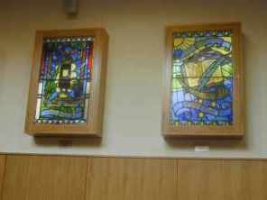
What can you see?
What can you see?

Slide 3
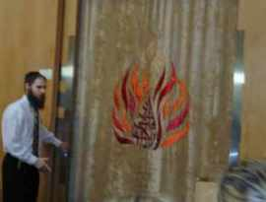
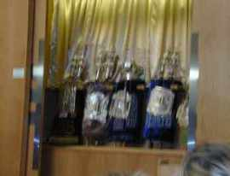
What can you see?
What can you see?

Slide 4
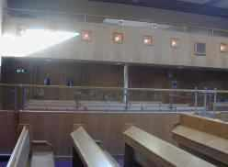
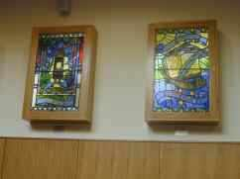
Discuss:
What symbols did you see?
What did you notice about the walls of the Synagogue?
Why are they like this?
Who do you think sits upstairs? Why do you think this is?
How can you tell that this is a place of worship ?

Slide 5
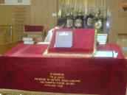
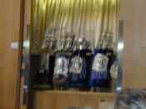
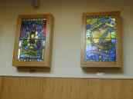
Matching features of the Synagogue.
The Ark is a special cupboard which is found facing Jerusalem on the Eastern wall. The Ark contains the Torah scrolls and represents the Holy of Holies in the Temple.
The Bimah is the reading desk which is found usually at the centre of the synagogue. It is where the Torah scrolls are read from.
Stained glass windows are found in some Synagogues. They depict Jewish history. Some will represent festivals that Jews celebrate for example Passover and Sukkot.
Torah Scrolls are kept in the Ark. Jews believe they are the word of God and they contain 613 laws which Jews should try and live by. They form part of the Jewish worship in the Synagogue.

Slide 6
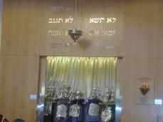
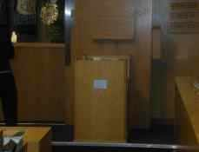
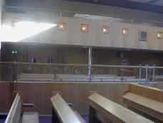
Matching features of the Synagogue.
The man and women sit separately in an Orthodox Synagogue to avoid distraction while worshipping. Women will usually sit in the women’s gallery upstairs and men sit downstairs.
The Ner Tamid is the everlasting light which represents the light that burnt in the Temple. The light represents Gods presence.
On the wall above the Ark there is often the 10 commandments, this reminds Jews of the 10 commandments given to their ancestors by Moses.
A seat(s) and a smaller reading desk is situated at the front by the Ark. These are for the officials who assist will the running of the Synagogue.

Slide 7
What am I...?

Slide 8
I am one metre in length when dressed in my lovely mantle and when my silver bells or a crown is placed on my head. My mantle is my jacket I wear when put in my cupboard called an Ark. I am treated with great respect, as I am God’s words. I am made of parchment, a thin animal skin. I am written by a man called a scribe.

Slide 9
I am one metre in length when dressed in my lovely mantle and when my silver bells or a crown is placed on my head. My mantle is my jacket I wear when put in my cupboard called an Ark. I am treated with great respect, as I am God’s words. I am made of parchment, a thin animal skin. I am written by a man called a scribe.
I have many other friends in the Ark with me to keep me company. Some have red jackets, some have blue ones. (I am the prettiest!!)

Slide 10
I am one metre in length when dressed in my lovely mantle and when my silver bells or a crown is placed on my head. My mantle is my jacket I wear when put in my cupboard called an Ark. I am treated with great respect, as I am God’s words. I am made of parchment, a thin animal skin. I am written by a man called a scribe.
I have many other friends in the Ark with me to keep me company. Some have red jackets, some have blue ones. (I am the prettiest!!)
I was chosen this year to be read in a boy’s Bar Mitzvah. I had to look my best! They took off my mantle and carefully unrolled me showing all my splendour. I felt so proud!

Slide 11
I am one metre in length when dressed in my lovely mantle and when my silver bells or a crown is placed on my head. My mantle is my jacket I wear when put in my cupboard called an Ark. I am treated with great respect, as I am God’s words. I am made of parchment, a thin animal skin. I am written by a man called a scribe.
I have many other friends in the Ark with me to keep me company. Some have red jackets, some have blue ones. (I am the prettiest!!)
I was chosen this year to be read in a boy’s Bar Mitzvah. I had to look my best! They took off my mantle and carefully unrolled me showing all my splendour. I felt so proud!
Yes of course, I am a Torah Scroll!!!

Slide 12
What am I...?
Feature
What do you know about it?
Describe what it looks like
Other important points
END

