Slide 1
Stages of
Moral Growth
... our morality grows and matures over time.

Slide 2
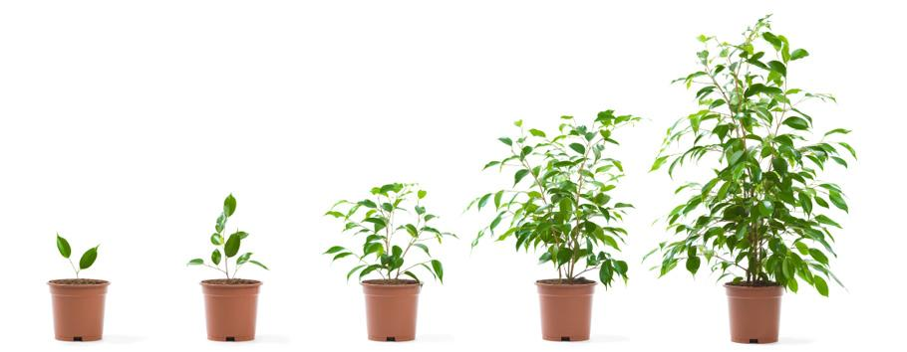
Growth is a gradual process....
Notes:
According to science what are the four elements required to make a seed grow; seed, water, soil, sunlight.

Slide 3
Reflection...
Watch this clip and in your copy write down how you think it relates to Moral Growth.

Slide 4
Moral Growth is a gradual process.
Notes:
The four elements needed for moral growth could be; tradition, experience, conscience and time.

Slide 5
Process of Moral Growth...
Selfishness
Altruism
Notes:
Explain the terms;
Selfishness - devoted to or caring only for oneself; concerned primarily with one's own interests, benefits, welfare, etc., regardless of others. (i.e. plants in the thick undergrowth competing for space and resources to grow.)
Altruism - behaviour that may lead to a person/things own disadvantage but that benefits others.

Slide 6
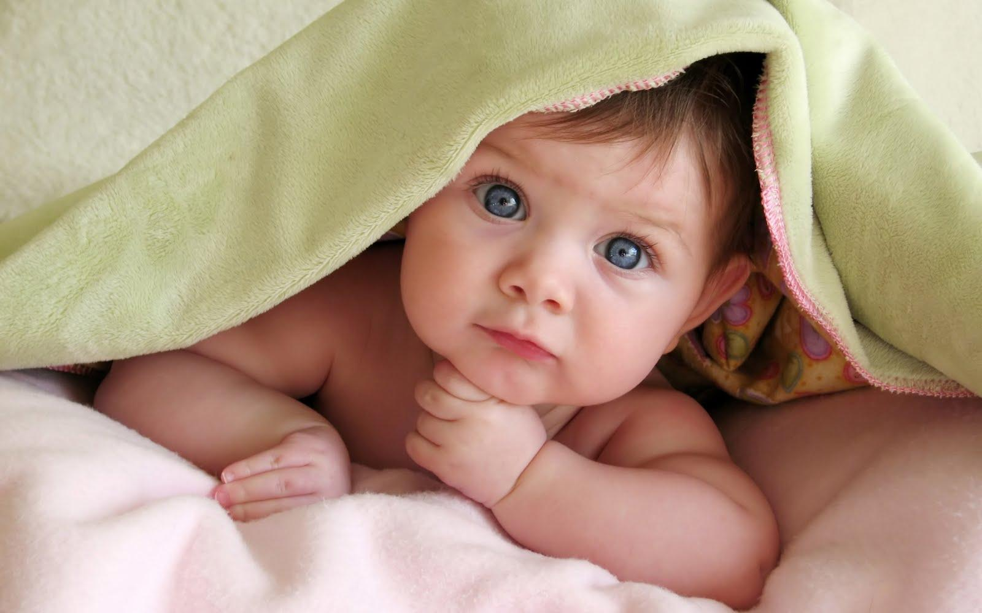
Stage 1 - Moral Immaturity
Notes:
Invite students to create their own captions, inspired by each picture, for each stage of moral growth.
When we are very young we only do the right thing if it benefits us. Our motivation to do good is selfishness.

Slide 7
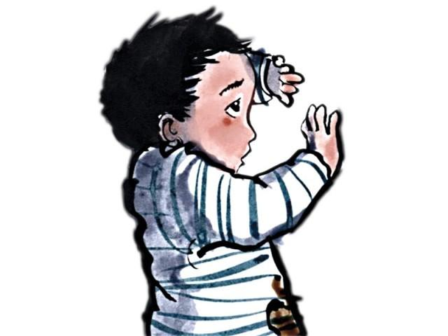
Stage 2 - Moral Steps
Notes:
This stage relates to fear of punishment - the motivation to do good is to avoid punishment and gain reward, not because of what is right or wrong.

Slide 8
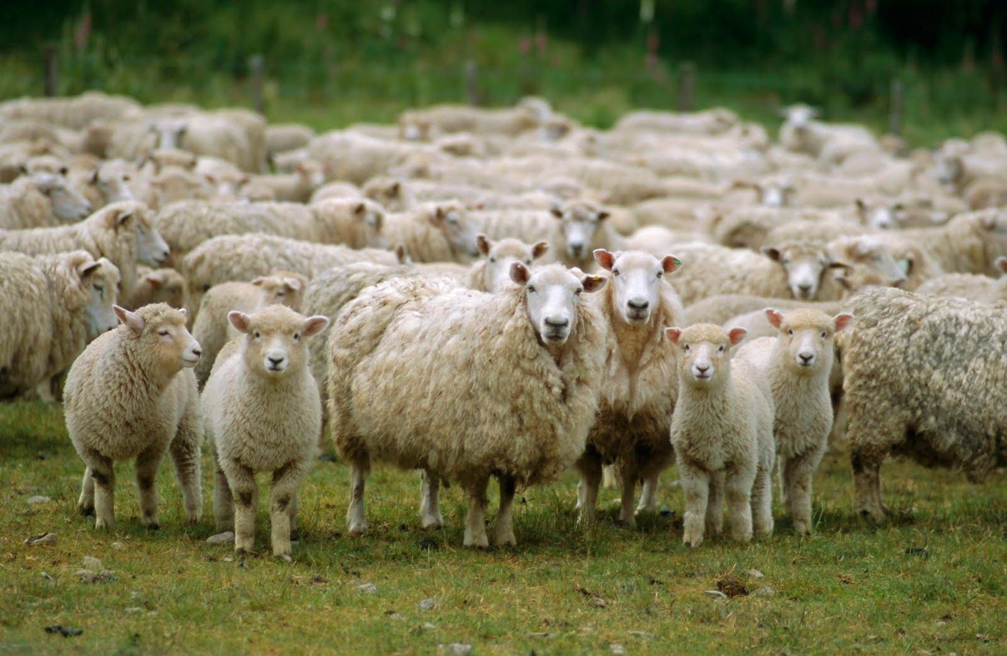
Stage 3 - Moral Sheep
Notes:
Motivation to do the right thing is approval from peers. We want to be that same, hence the name 'moral sheep'.

Slide 9
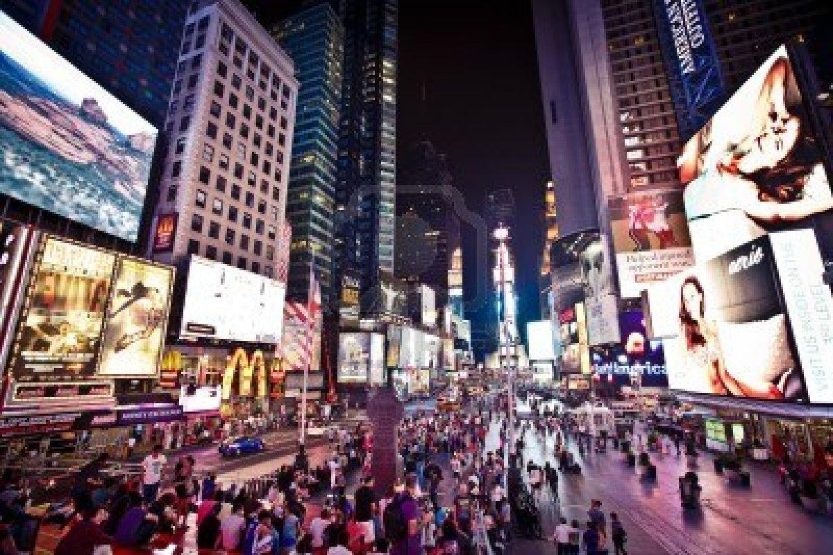
Stage 4 - Moral Society
Notes:
Motivation to do good is influenced by society and promoting behaviour for the common good of all.

Slide 10
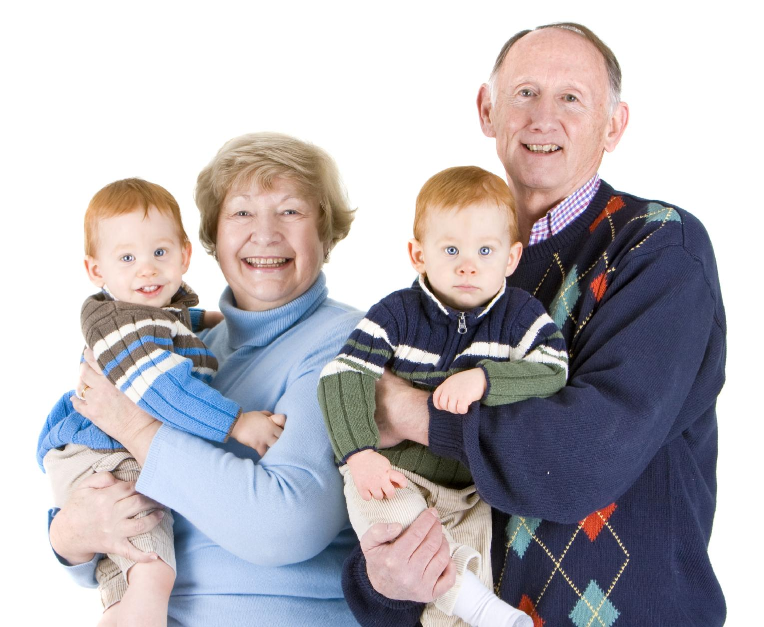
Stage 5 - Moral Maturity
Notes:
A person reaches the stage of moral maturity when they behave in a way that upholds the values of justice, peace, respect, truth, love and forgiveness - which they can then pass on to younger generations.

