Slide 1
Signs and Symbols
Ms Dunlop
3rd year Religion

Slide 2
Signs
A sign is something that communicates a brief message. A sign can be a word, a picture, an object or an action. Signs should be easy to recognise and their meaning should be obvious.
Many signs are internationally recognised.
A sign does not affect us in any significant way. It offers a simple message with the same meaning for every one.

Slide 3
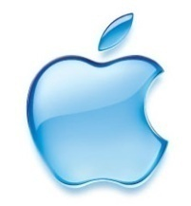
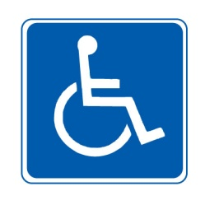
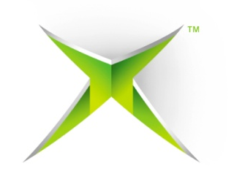
Identify the signs

Slide 4
Check answers
Adidas Recycle Vodafone Pharmacy
Disabled Chanel Apple
X-Box Sony HMV

Slide 5
Symbols
Symbols are more powerful then signs because they affect how we feel.
Symbols work well when we find it difficult to put our thoughts or feelings into words. People often use them to express emotions.
A symbol is something visible, an object or action, that represents something invisible that is difficult to put into words.

Slide 6
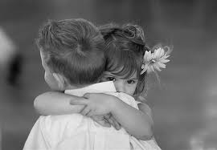
Symbolic Action
When a person dies it can be difficult to find the right words. The depth of our grief is expressed in an embrace or in a shared moment of silence .

Slide 7
Symbolic Actions
Hug, I love you,
goodbye, I’m
sorry or don’t
worry.
Hand Shake
Symbols we use to express our feelings

Slide 8
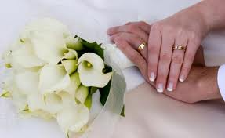
Symbolic Objects
When a couple are in love, they can talk endlessly about their feelings for one another, yet their deepest feeling will be expressed in the exchange of their rings.

Slide 9
Symbolic Objects
Symbolic objects we use to express our feelings

Slide 10
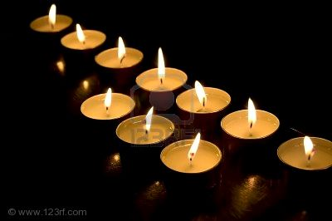
Write down what this symbol brings to mind?
Hope
Faith

Slide 11
Religious Symbols
The world of the sacred is an invisible reality. God is invisible, yet is very real for people of faith. People use the language of symbol when they want to communicate with God. The experience is so special that ordinary language, by itself, cannot fully express everything that needs to be said. Christians therefore communicate with God through symbols.

Slide 12
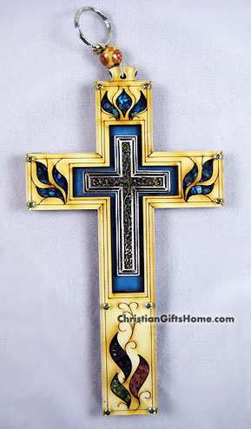
Religious symbols
Christians believe that Jesus, the Son of God, was put to death on the cross. He was buried, and rose again from the dead. The crucifixion and the resurrection are the central events in the Christian faith. The Cross is a symbol of these major Christian beliefs.

Slide 13
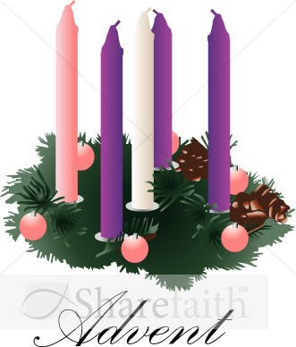
Religious Symbols

Slide 14
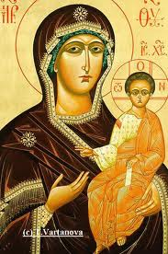
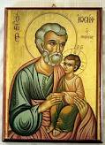
Icons
The word‘icon’ is Greek and means image. In the world of the sacred, an icon is a very precious religious image or painting.
Icons are sacred images of Jesus, Mary and the saints.
‘The eyes of the icon is like the eye of God. God reaches out and draws us near. God reaches right into our hearts. The icon brings us closer to god.’ Orthodox Christian.
Notes:
An icon is not meant to be a life-like portrait of a sacred person. Icons are a particular type of religious painting, very different from other works of art. They may appear strange or unusal to people who are unfamiliar with them.

Slide 15
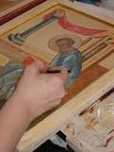
Iconographers
A person who creates icons are called iconographers.
The art of painting these sacred images is very specific. Before beginning work, the artist fasts, prays, meditates and receives the sacraments of Reconciliation and Eucharist
Iconographers believe that the inspiration for their work comes from God.
Notes:
Read page 367.

Slide 16
Religious Icon.

Slide 17
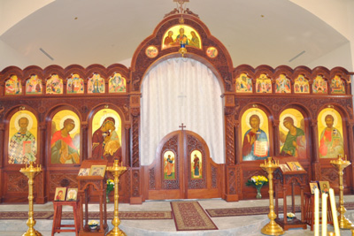
Iconostasis.
The word ‘iconostasis’ means the place of the icons.
This is a solid screen, in front of the alter, which divides the alter in two. The iconostasis symbolises the separation between the world of heaven and earth.
Notes:
Icons cover the walls and pillars inside the Church. The royal doors are in the centre. They are opened during divine Liturgy to reveal the alter and the sanctuary beyond. Thus the priest symbolically brings heaven closer to earth.

Slide 18
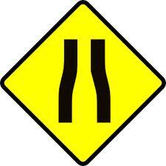
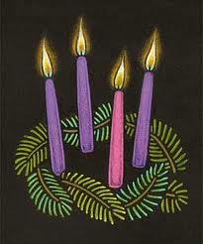
Recap of signs and symbols
What is the difference between a sign and a symbol.
A person who creates a religious icon is called?
A symbol is……
Name the three types of symbols?
List three symbolic actions?
A sign is……
Explain why the cross is a religious symbol?

