Slide 1
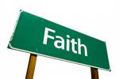
Section D – The Question of Faith
Key Concepts & their explanation...

Slide 2

Agnosticism
...the view that human beings cannot know for certain whether or not God exists.

Slide 3

Atheism
... a view that denies the existence of God.

Slide 4
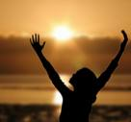
Awe & Wonder
... feelings inspired by mysterious aspects of life.

Slide 5
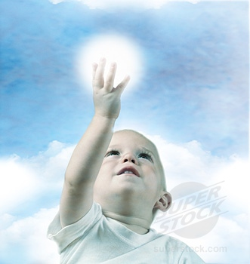
Childhood Faith
... a simple trust in God and acceptance of one’s parents faith.

Slide 6
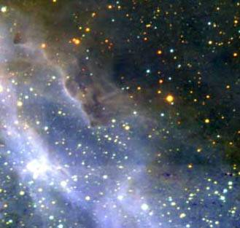
Creation
... views on the origin of the universe and life on earth.

Slide 7
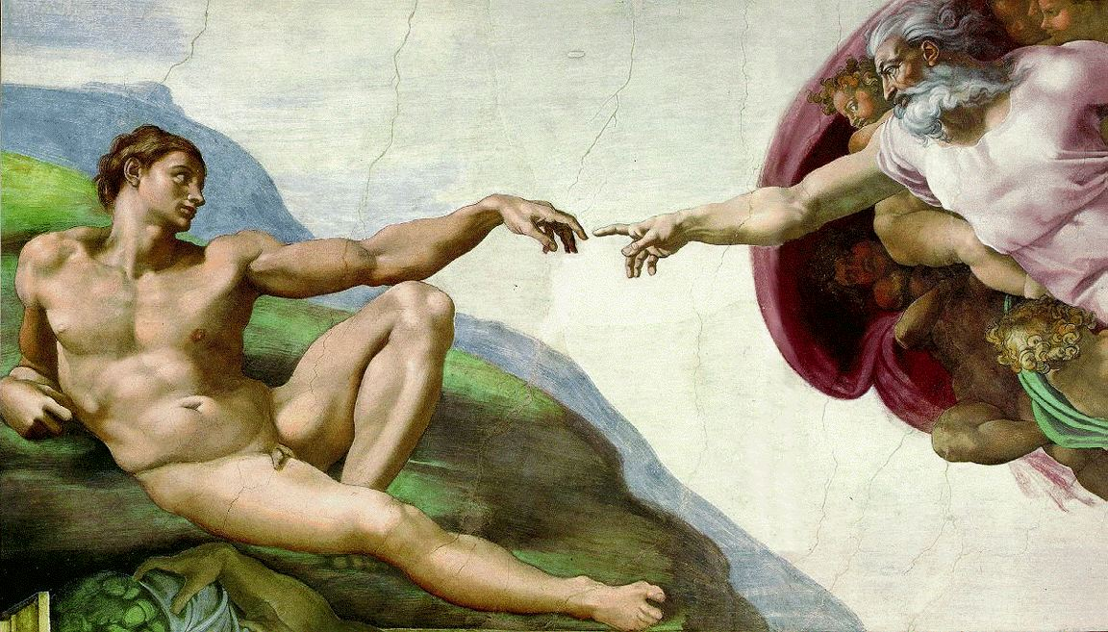
Experiencing God
... being aware of God’s mysterious presence.

Slide 8
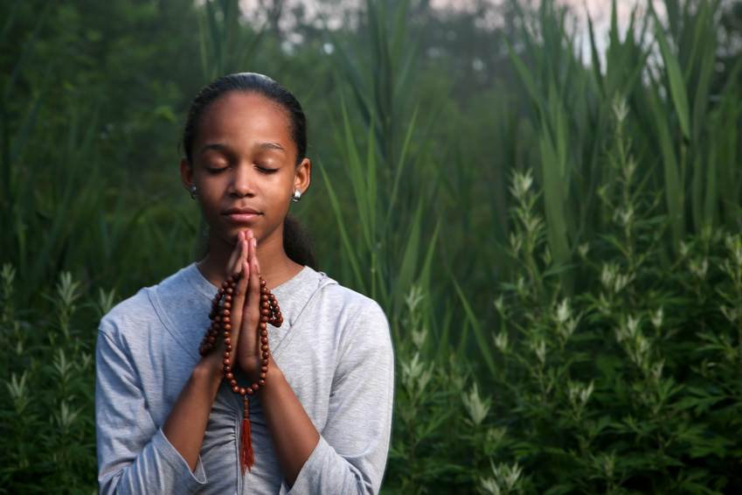
Faith
... a strong inner belief and trust in God.

Slide 9

Fundamentalism
... the view that a sacred text is a factual account and must be taken literally, word for word.

Slide 10

Humanism
... a belief system that rejects religion and makes sense of life through human reason alone.

Slide 11
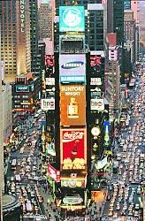
Materialism
... the view that nothing is real except physical matter.

Slide 12
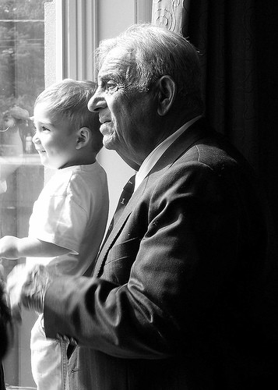
Mature
Faith
... a close relationship with God and an active commitment to one’s faith.

Slide 13

Meaning
... to find or have a sense of purpose in life.

Slide 14
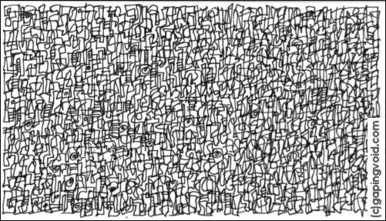
Meaninglessness
... failing to find meaning
or purpose in life.

Slide 15
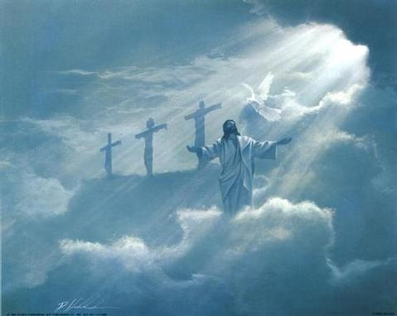
Monotheism
... the belief in one God.

Slide 16
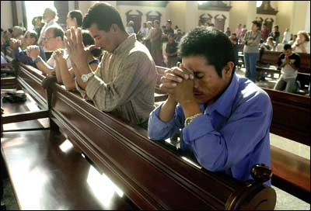
Personal Faith
... a person’s own religious belief.

Slide 17
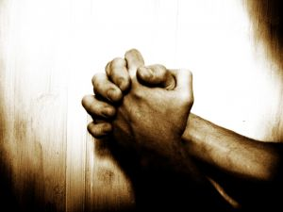
Prayer
... the way people of faith communicate with God.

Slide 18
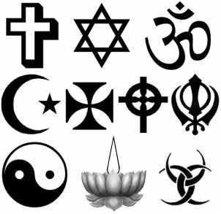
Polytheism
... the belief in many gods.

Slide 19
Question
... the act of asking questions
e.g. about the meaning of life.

Slide 20
Questioner
... the person who asks questions and seeks the truth.

Slide 21

... thinking deeply
about some aspect of life.

Slide 22
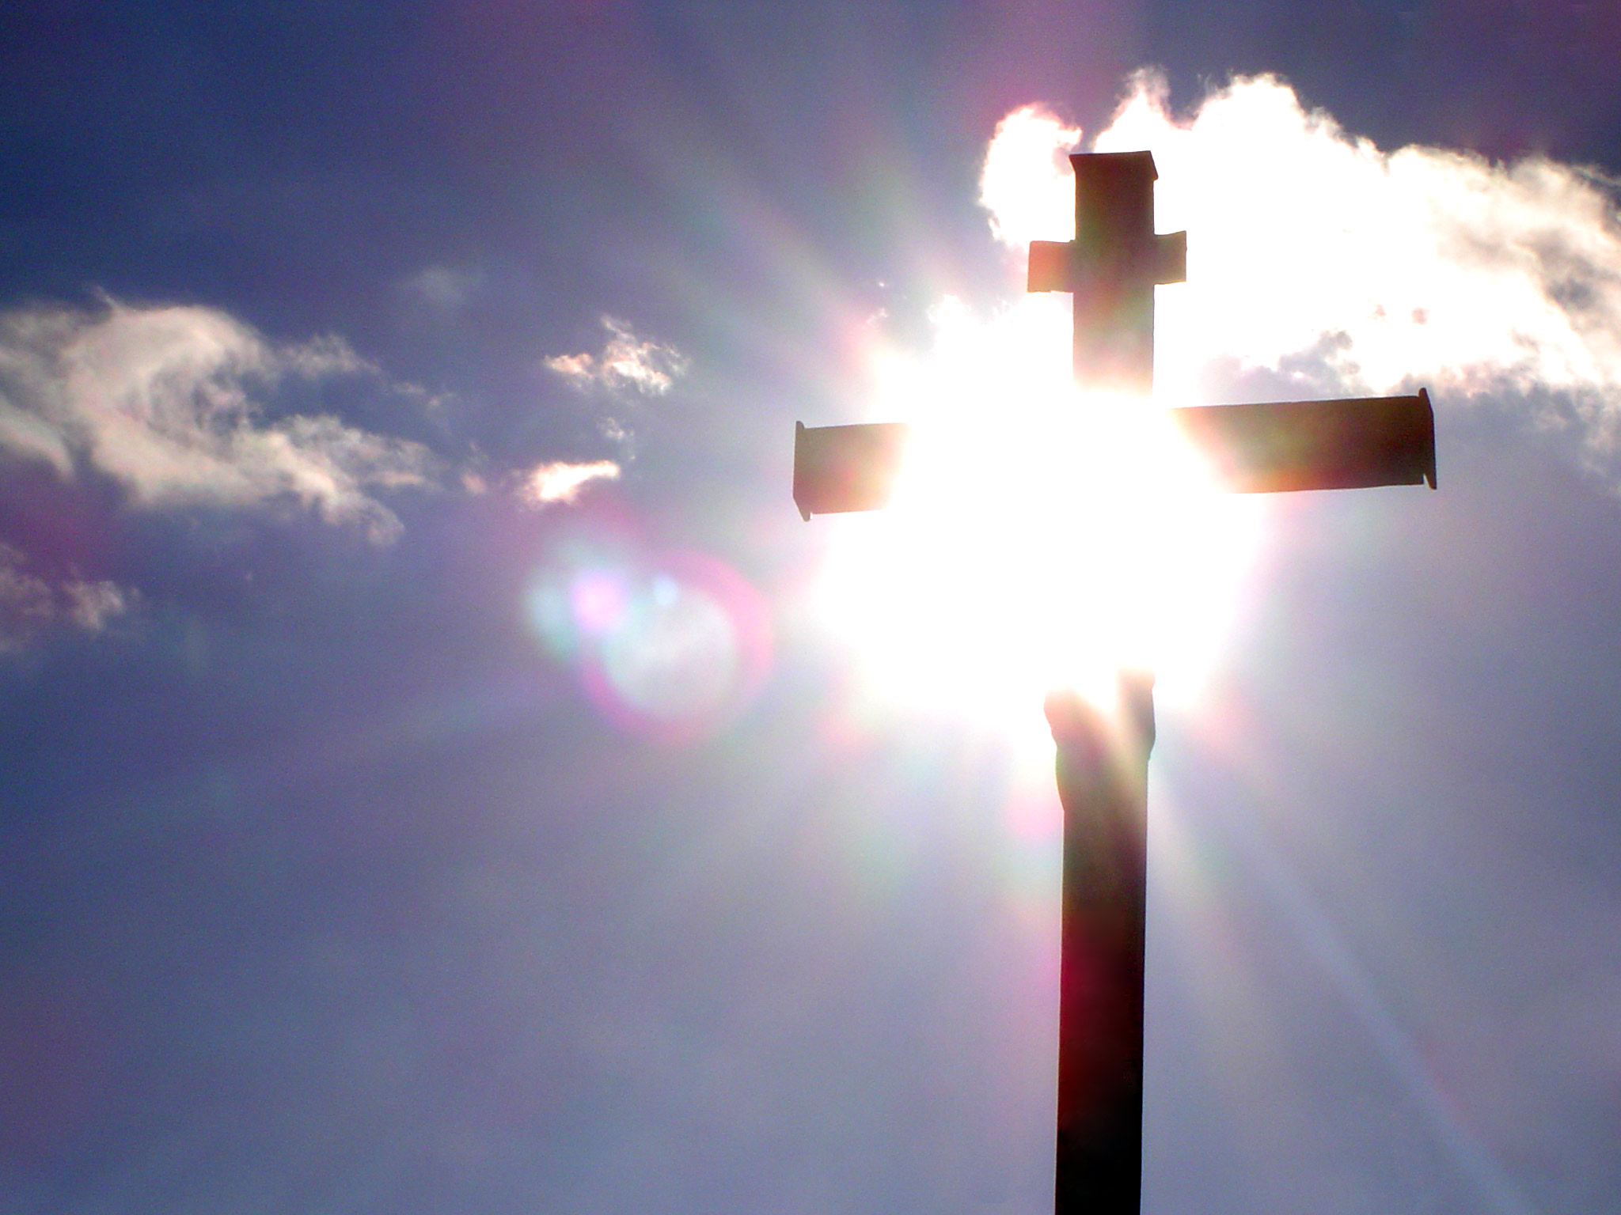
Religious Belief
... a set of ideas about God, or gods, that people accept as true.

Slide 23
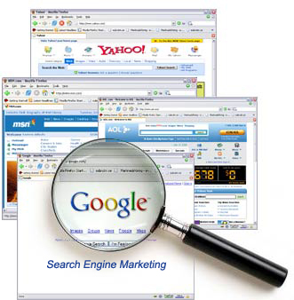
Search
... the deep human need to find meaning in life.

Slide 24
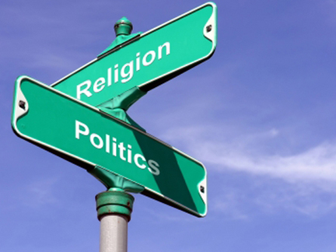
Secularism
... the view that organised religion should have no direct influence on society.

Slide 25
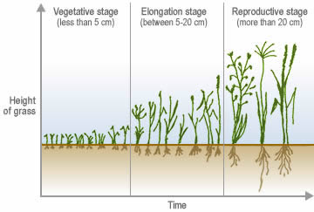
Stages of Faith
... the development of a person’s relationship with God from childhood faith to mature faith.

Slide 26
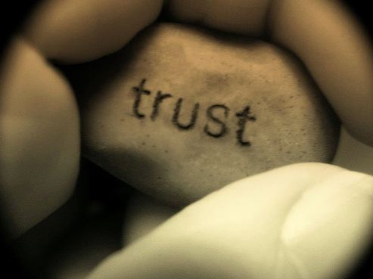
... being able to rely on a person
with complete confidence.

Slide 27

World View
... the way people look at life and try to understand it.

Slide 28

Worship
... the way people of faith praise and honour God in prayer and at religious services.

