Slide 1
Section C:
Foundations of Religion,
Major World Religions.
Key Concepts

Slide 2
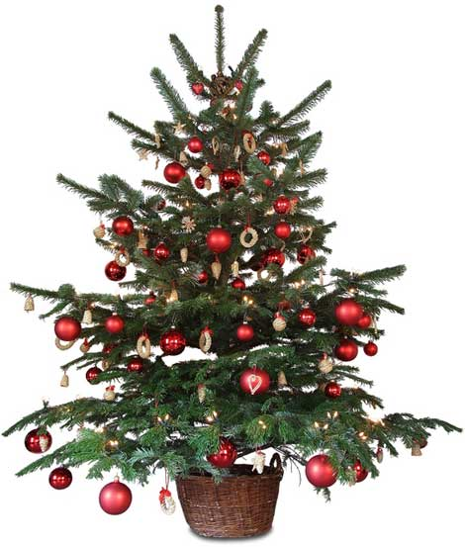
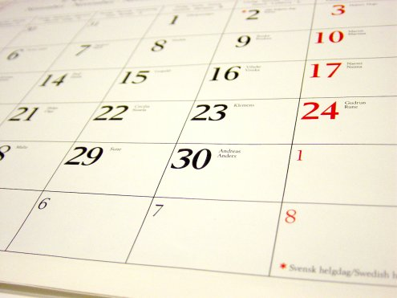
Calendar/Sacred Time
A calendar is a system for dividing the year into definite periods. Sacred Time refers to times of special religious importance e.g., religious festivals.

Slide 3
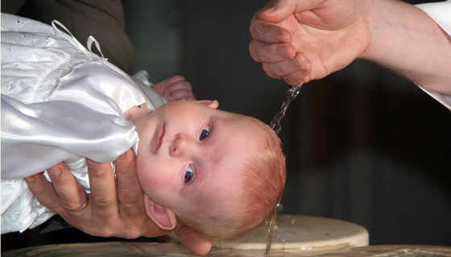
Ceremony
A formal event to celebrate and show respect for something, for example, a baptism or a wedding.

Slide 4
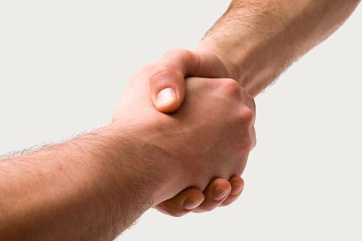
Commitment
A pledge or promise to a group or community to carry out a task or a role.

Slide 5
Community Structure
The way in which a group of people with a common interest is organised, especially in its roles (leadership, membership etc.,)

Slide 6
Creed
A statement
of religious
beliefs.

Slide 7
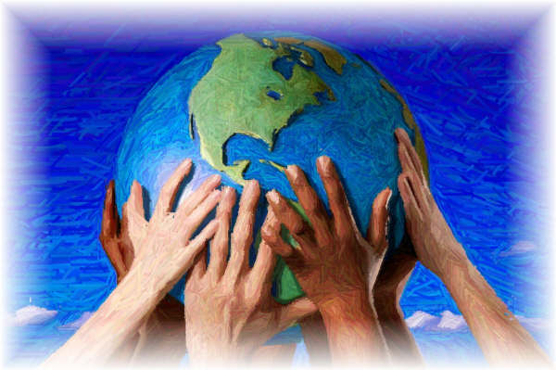
Cultural Context
The events, facts, stories and customs of a particular culture or society that connect with and influence other events, e.g. the founding of a major world religion.

Slide 8
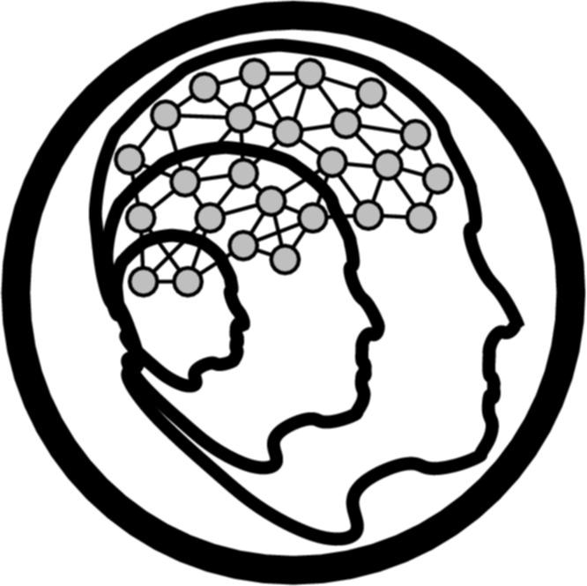
Development
Growth or change, e.g. the way in which a community of faith grows or matures over time.

Slide 9
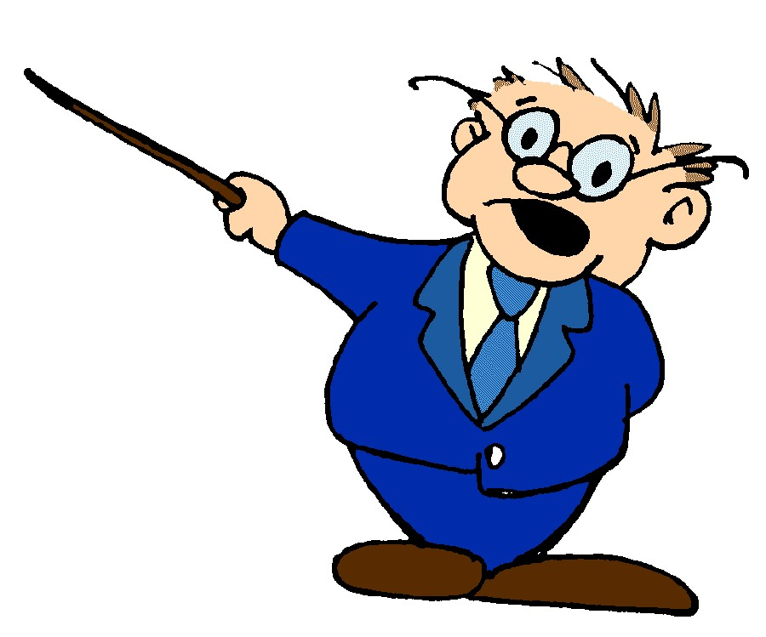
Education
The teaching or passing on of knowledge.

Slide 10
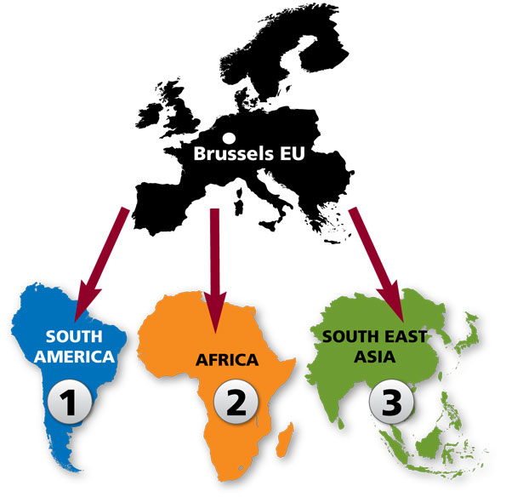
Expansion
Increase in size, area or number. A religious community expands when more people join it and when it spreads to other places.

Slide 11
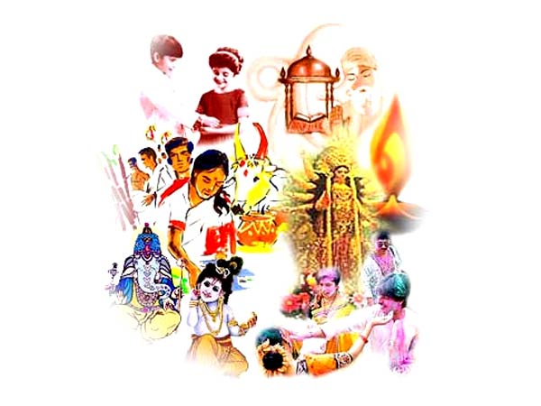
Festivals
Special celebrations that recall the events, facts stories and customs of a particular group, nation or religion.

Slide 12
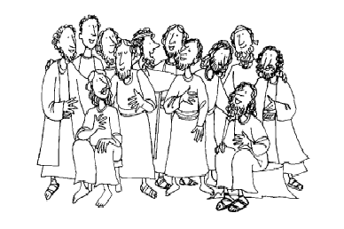
Follower/Disciple
A person becomes a follower when they take on discipleship. This means that they begin to live by the traditions of a community of faith

Slide 13
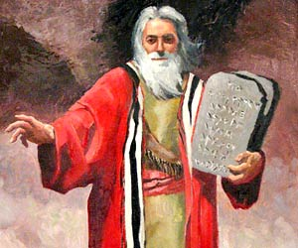
Founder
A person whose teaching and example leads to the formation of a group or community vision.

Slide 14
Inspiration
Something that stirs our imagination and that influences us to new thinking or action.

Slide 15
Leadership
Setting a goal or aim for a person or a community and guiding them towards it. Always involves some degree of authority.

Slide 16
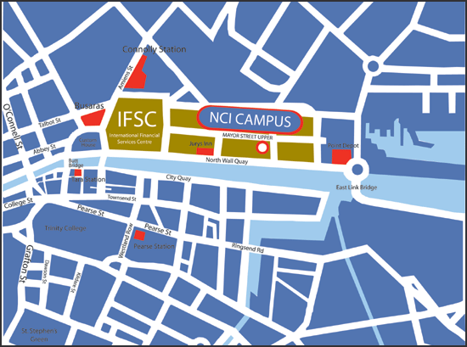
Location
A particular place, e.g. a town, city or country.

Slide 17
Meditation
Focusing attention/thoughts on a story, object or person in order to be more aware of them. Christian meditation focuses on God and the love of God as shown in Jesus Christ.

Slide 18
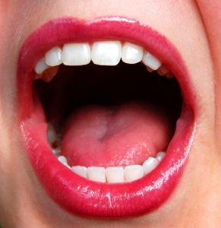
Oral Tradition
Information that is handed on by word of mouth from one person or group to another.

Slide 19
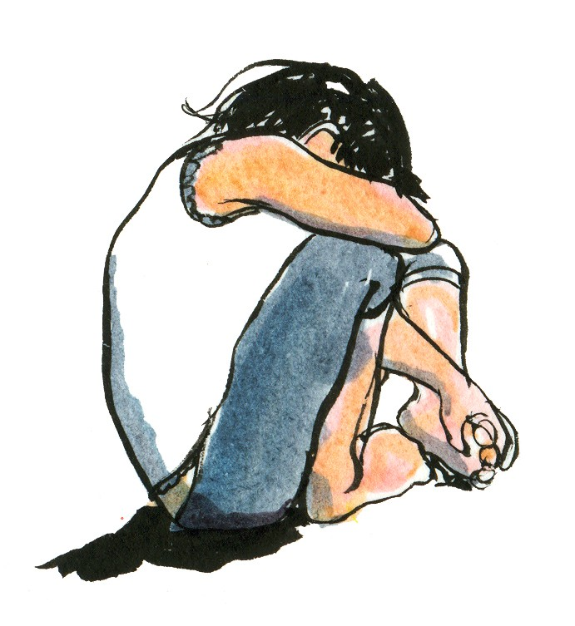
Persecution
Deliberately causing loss, pain or death to a person or a group because of race, religion or way of life.

Slide 20
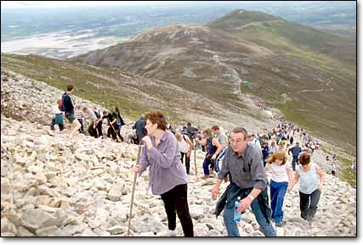
Pilgrimage
A journey to a sacred place.

Slide 21
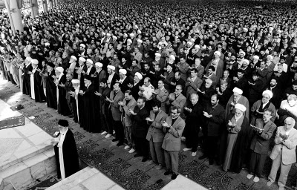
Places of Worship
Places set apart for religious rituals.

Slide 22
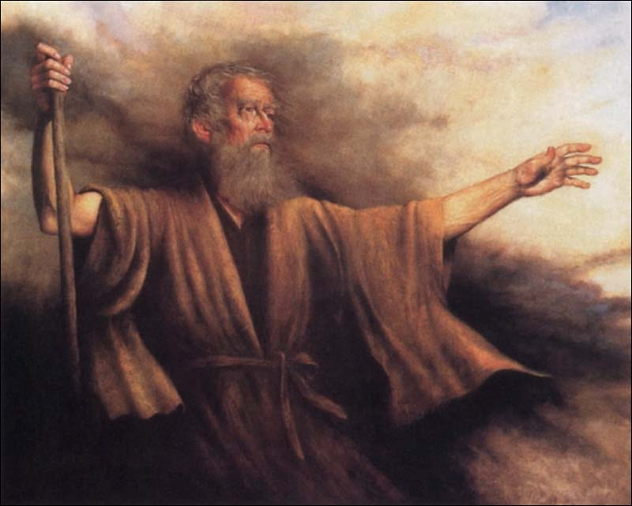
Prophet
A person
who
speaks on
behalf of
God.

Slide 23
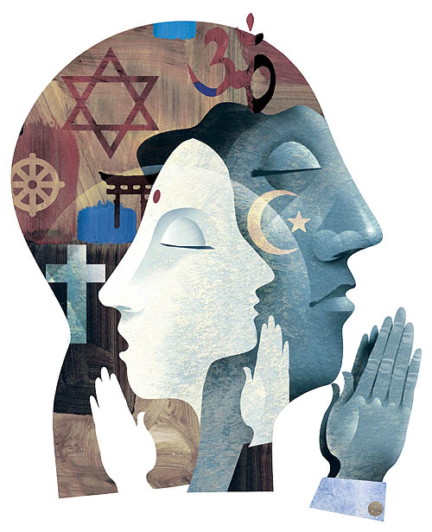
Practice
The practice of a faith tradition means the living of that faith according to its central beliefs and teachings.

Slide 24
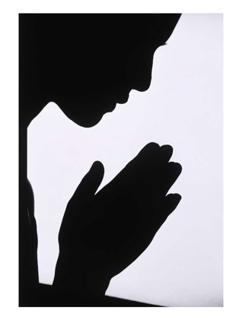
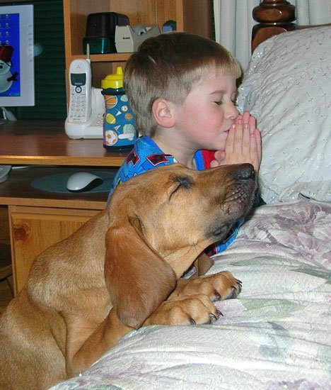
Prayer
Communication between people and God.

Slide 25
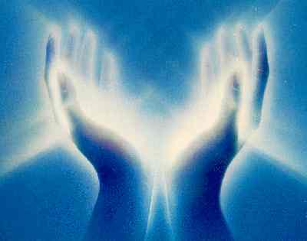
Revelation
The act of revealing or showing something. Used to describe how God and God’s message were revealed to the founders of Judaism, Christianity and Islam.

Slide 26
Rite
A set of words or actions used to celebrate or mark an important event. ‘Rites of passage’ celebrate different stages in a person’s life.

Slide 27
Ritual
A series of actions carried out in a set way. Religious rituals are usually repeated regularly by the faith community to express the relationship between God and the community.

Slide 28
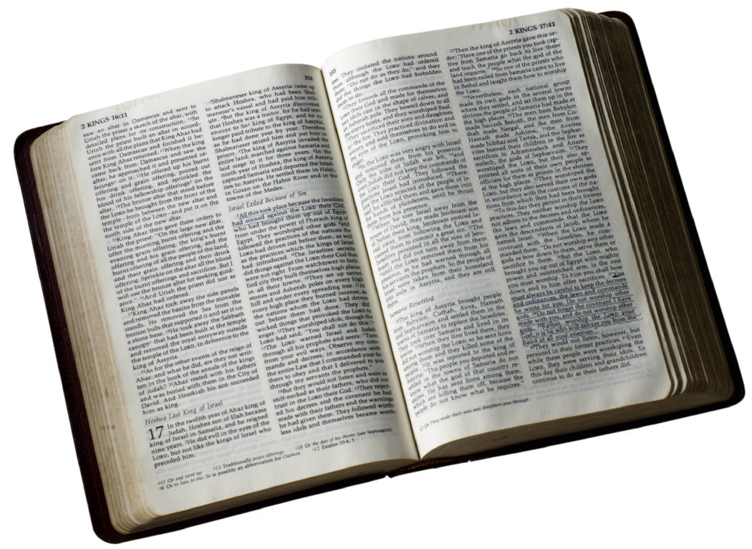
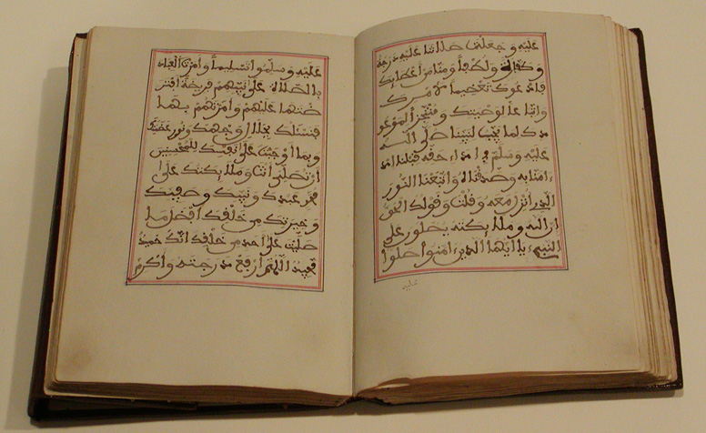
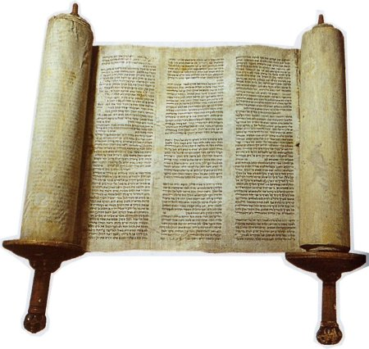
Sacred Text
Writings relating to a community of faith, which are considered holy and inspired.

Slide 29
Schism
A split, especially in relation
to a religious tradition.

Slide 30
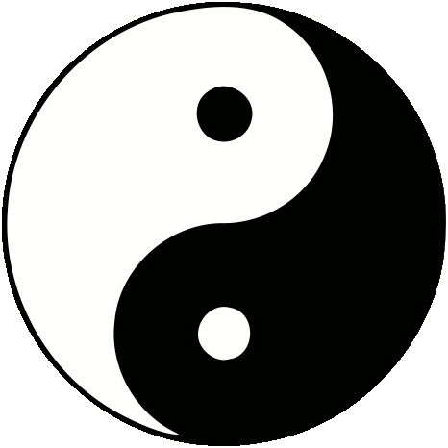
Symbol
A type of sign, but with a deeper meaning.
A symbol is a visible sign of something invisible.

Slide 31
Tradition
The handing down or information, beliefs and customs from one generation to the next. Religious tradition involves the handing on of religious practices, beliefs, etc.

Slide 32
Vision/Dream
A powerful image of what the world or a person or a group could be.

