Slide 1
Foundations of Religion;
Christianity
Part 1: The Context
Part 2: Evidence about jesus
Part 3: The Person and
preaching of jesus
Part 4: The Death and
resurrection of jesus
Part 5: Faith in christ

Slide 2
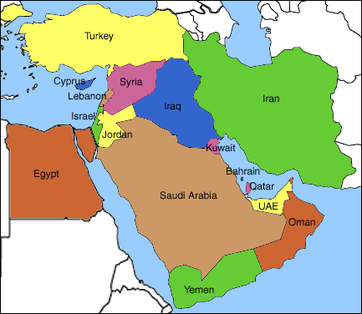
Part 1: The Context

Slide 3
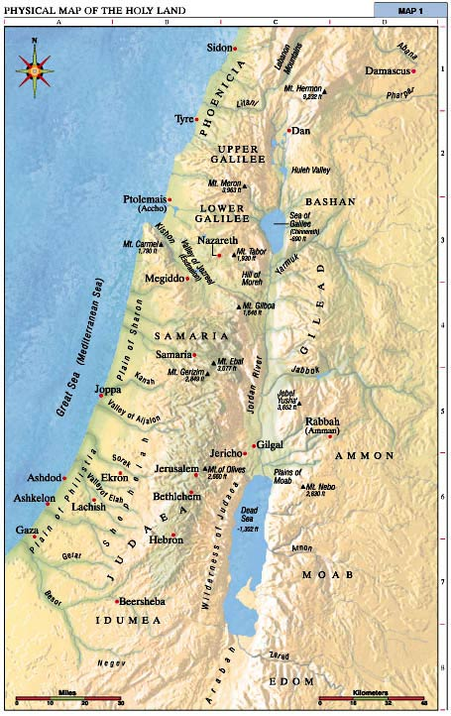
The Holy Land
A name for Palestine, the country where Jesus was born.

Slide 4
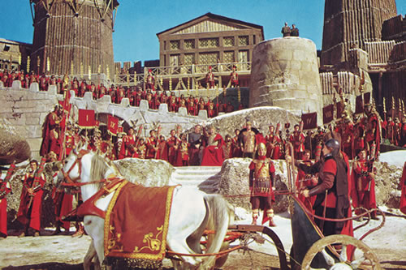
The Roman Empire:
…the area around the Mediterranean Sea ruled by ancient Rome.

Slide 5
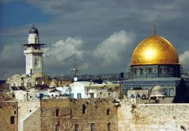
Ancient Judaism:
…the religion of the Jews from the
time of Abraham to the arrival
of the Roman Empire.

Slide 6
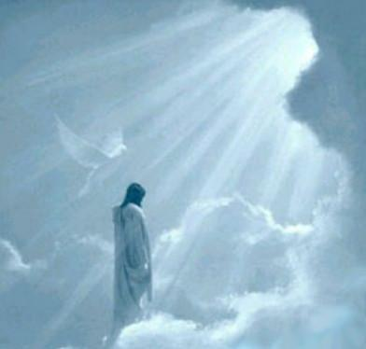
Messianic Expectation:
The hope expressed by Jews in Jesus’ time that God would send a Messiah, a great leader, to free them from Roman rule.

Slide 7
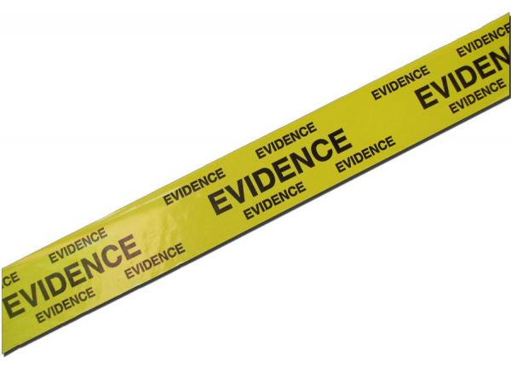
Part 2: Evidence about jesus
Evidence:
… information collected from different sources to prove an important point.

Slide 8
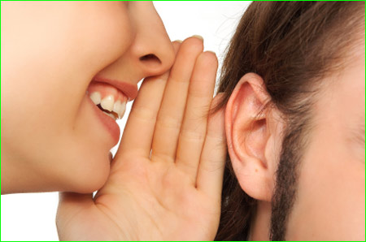
Oral Tradition:
… accounts of Jesus’ life and teaching passed on by word of mouth.

Slide 9
Written Tradition
… accounts of Jesus’ life and teaching written in the gospels of
Matthew,
Mark,
Luke,
John

Slide 10
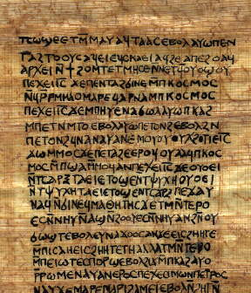
Gospel:
… means “good news”. The message of Jesus in the four gospels of the New Testament.

Slide 11
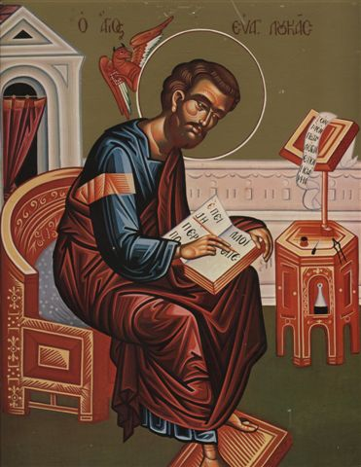
Evangelist:
… a person who wrote a gospel to spread the “good news” of Jesus Christ.

Slide 12
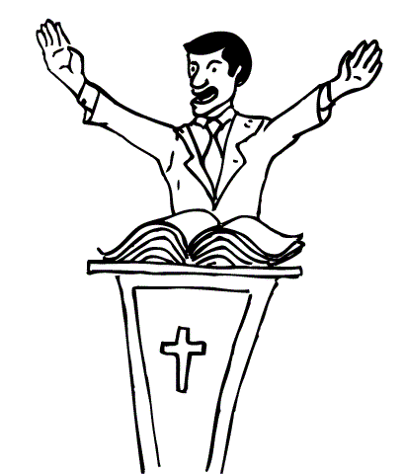
Witness:
… means to proclaim or publicly announce one’s religious faith. The evangelists wrote the gospels to proclaim their deep faith in Jesus.

Slide 13
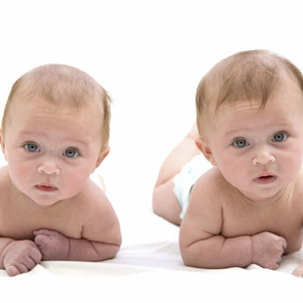
Synoptic: Is to be alike or similar. The gospels of Matthew, Mark, Luke and John are so alike they are known as the Synoptic Gospels.

Slide 14
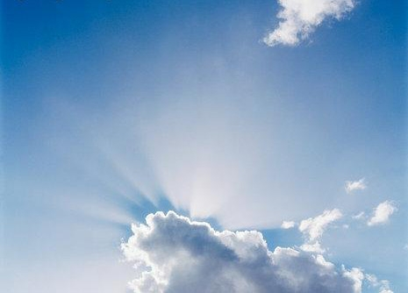
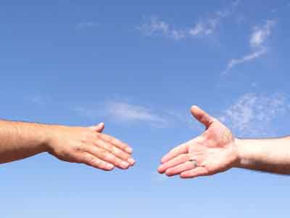
Part 3: The Person and preaching of jesus
Kingdom of God
… Jesus’ vision of a perfect world, where people allow the love of God to rule their hearts

Slide 15
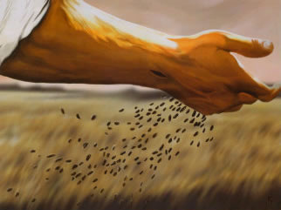
… in parable …
… short stories about familiar events used by Jesus to teach people about the Kingdom of God.

Slide 16
… in miracle …
… amazing cures or events used by Jesus to show people the power and love of God.

Slide 17
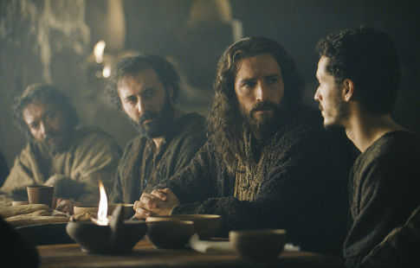
… in table-fellowship …
… Jesus shared meals with all kinds of people to show the Kingdom of God is open to everyone.

Slide 18
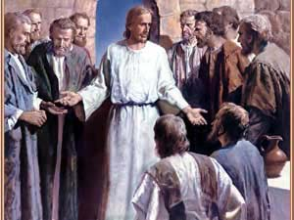
… in discipleship …
… Jesus chose twelve disciples to follow him and learn about living in the Kingdom of God.

Slide 19
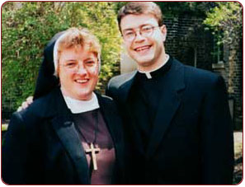
Vocation
… a way of life that a person feels God is calling him/her to follow.

Slide 20
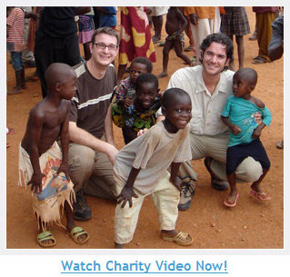
Mission…
… the specific work carried out by members of a Christian community today

Slide 21
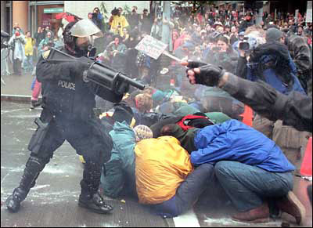
Part 4: The Death and resurrection of jesus
Conflict With Authority
… a clash or struggle with powerful people or organisations.

Slide 22
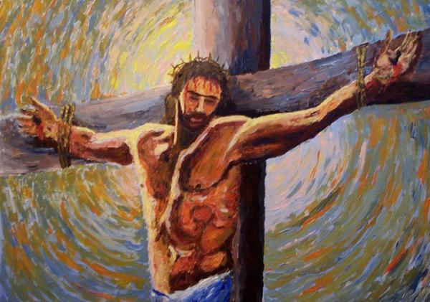
Sacrifice
… something of value (a life, for example) offered up to God.

Slide 23
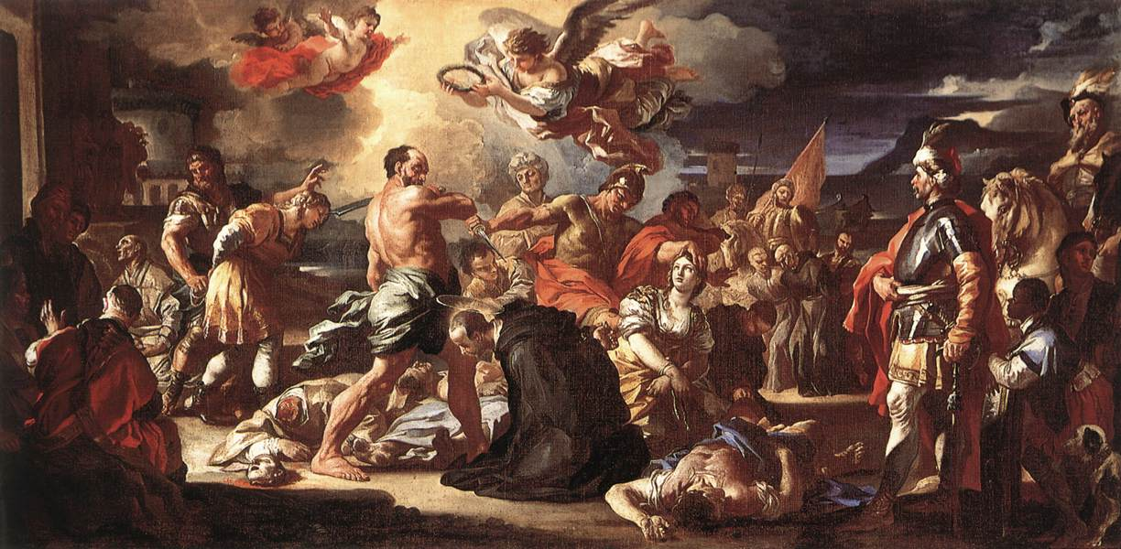
Martyrdom
… the suffering and death of a person who dies for their beliefs or a special cause.

Slide 24
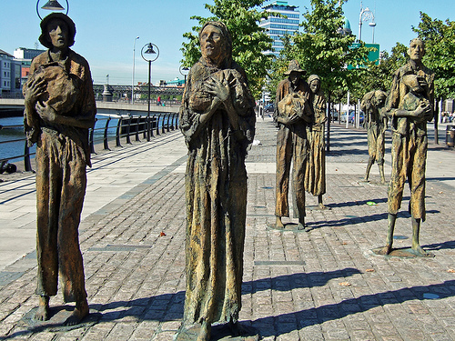
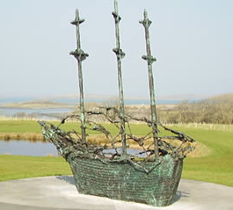
Memorial
… a formal event or occasion to remember and re-live something important.

Slide 25
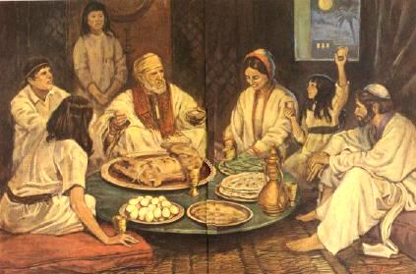
Passover
… a Jewish festival celebrating the Exodus of the Jewish people from slavery in Egypt.

Slide 26
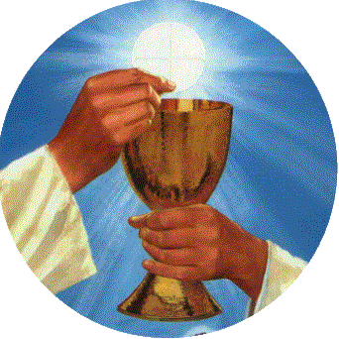
Eucharist
… a service of thanksgiving for Christ’s sacrifice.
We celebrate this at the weekly Mass on Sunday.

Slide 27
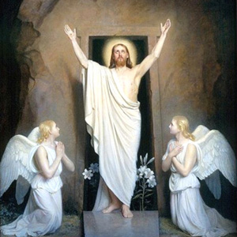
Resurrection
… the central Christian belief that Jesus rose from the dead three days after he was crucified.

Slide 28
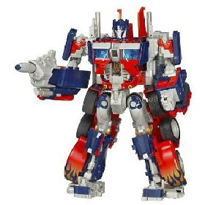
Transformation
… a complete change in the appearance and nature of a person or thing.

Slide 29
Presence
… the fact that a person exists and is truly present here and now.

Slide 30
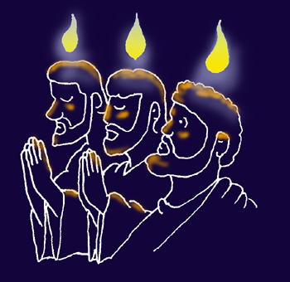
Part 5: Faith in christ
Pentecost
… the day the apostles received the Holy Spirit and began to spread the message of Jesus.

Slide 31
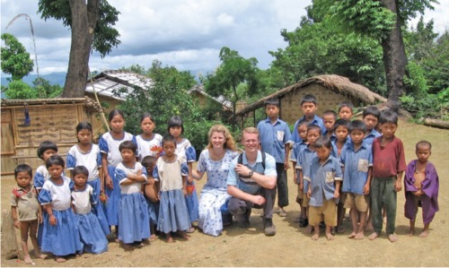
Missionary
… one who is sent on a journey to spread the Gospel by preaching, or by example.

Slide 32
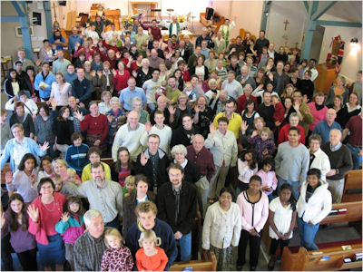
People of God
… Christian communities, past and present, who share the same faith, worship and way of life.

Slide 33
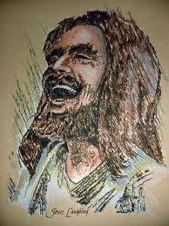
Son of Man
… a title that shows the human nature of Jesus.

Slide 34
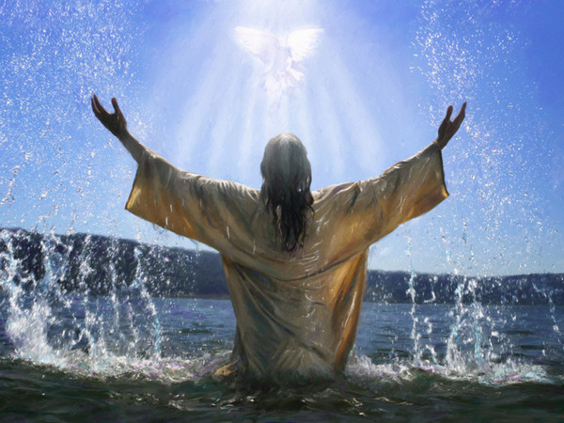
Son of God
… a title that shows the divine or holy relationship that exists between Jesus and God the Father.

Slide 35
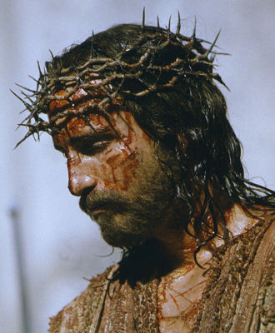
Christ/Messiah
… a title meaning ‘anointed one’.
Jesus is the Saviour sent by God to be a spiritual leader, not a political one.

