Slide 1
Section A:
Communities of Faith

Slide 2
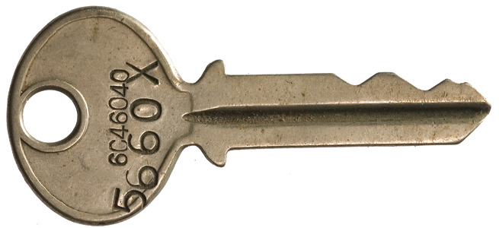
What is a Key Concept?
... An important idea whose meaning
you need to learn.

Slide 3
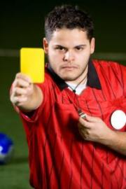
Authority
...... the power that a person in a position of leadership has to make decisions for or about a group or community.

Slide 4
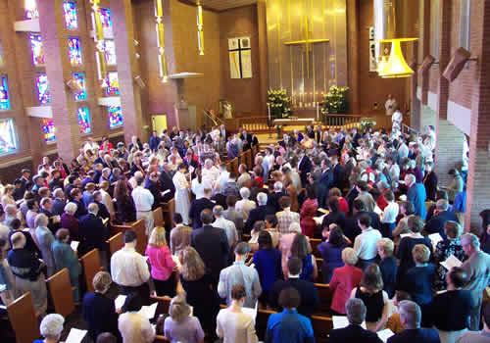
Church
... a community of faith. Also used to describe a building in which people worship.

Slide 5
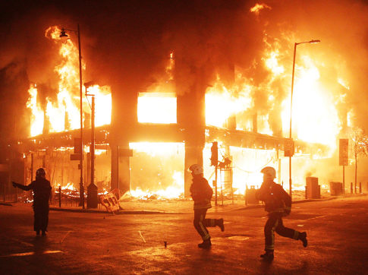
Community Breakdown
... occurs when a group stops working/sharing and breaks apart.

Slide 6
Commitment
... pledge/promise to a group or community to carry out a task or role.

Slide 7
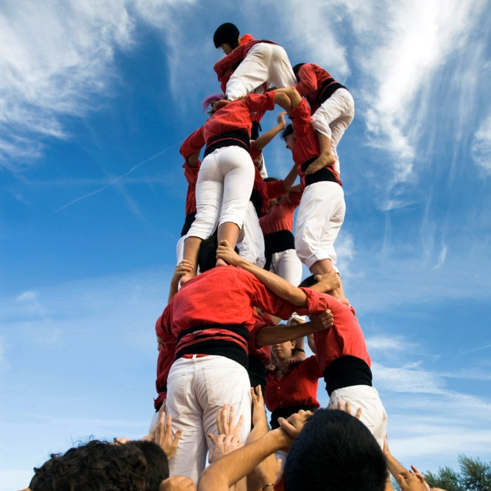
Co-operation
... working together to achieve a common goal.

Slide 8
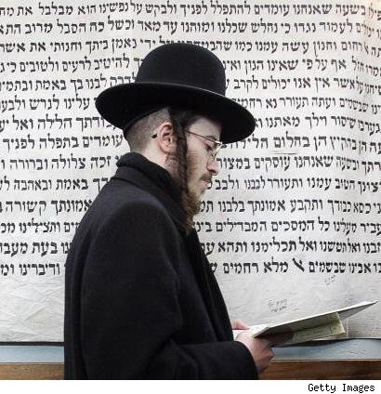
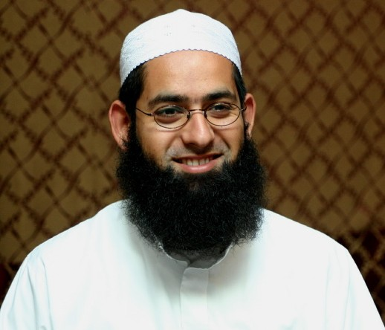
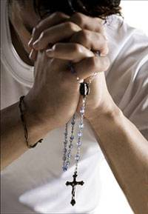
Denomination
community of faith, with its own particular organisation and practices.

Slide 9
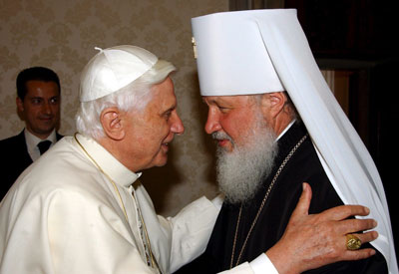
Ecumenism
... name given to the movement that works to promote greater unity between the different Christian communities.

Slide 10
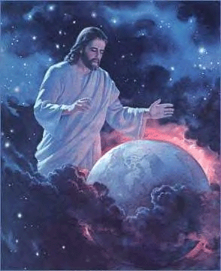
Faith/Belief
... something accepted as true by a person or group. Our faith or belief in God is at the heart of our religion.

Slide 11
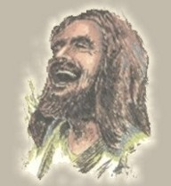
Founder
... a person whose teaching and example leads to the formation of a group or community vision.

Slide 12
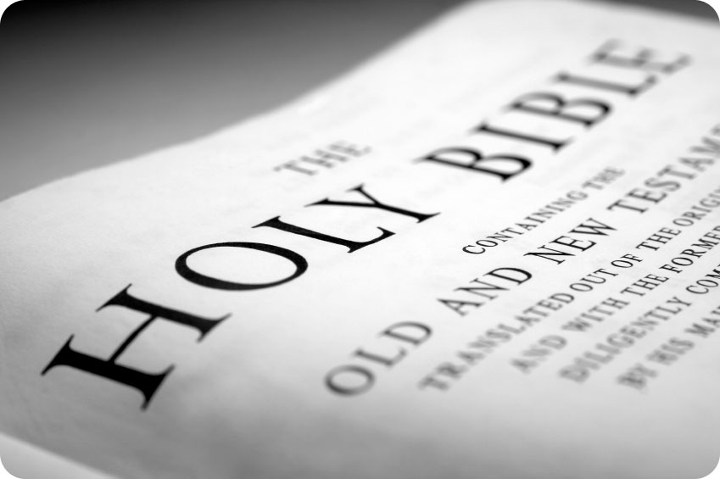
Gospel
... means
‘good news’
and refers to the good news of God’s love that Jesus brought to all people.

Slide 13
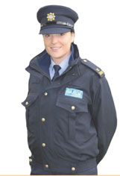
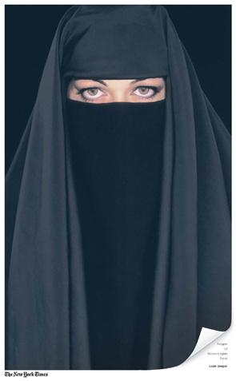
Identity
... that which makes it possible to know who a group or person is.

Slide 14
Inter-Faith Dialogue
... when members of different communities of faith (different religions) talk together
in order to come to a better
understanding of their beliefs.

Slide 15
Lack of Co-operation
... not working together.

Slide 16
Leadership
... setting a goal or aim for a person or a community and guiding them towards it.

Slide 17
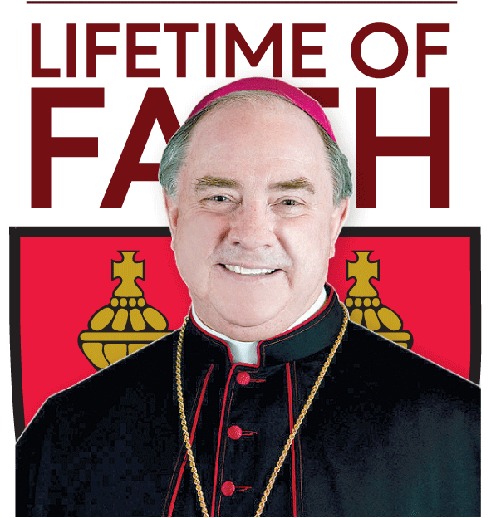
Ministry
... role of service given to a member by a community and/or its leader.

Slide 18
Mission
... a specific task given to a person or group.

Slide 19
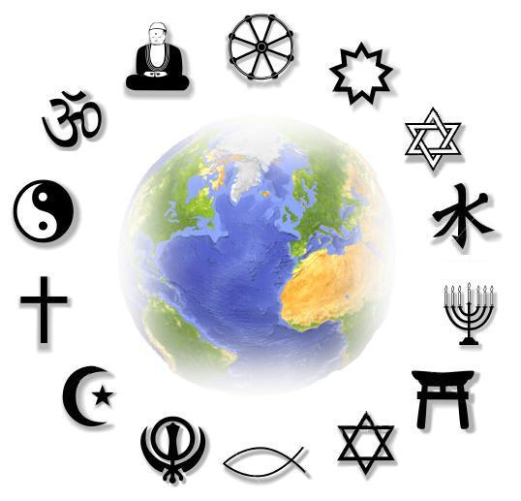
Religions
... systems of practices (actions) and rules to show a groups search for and belief in God.

Slide 20
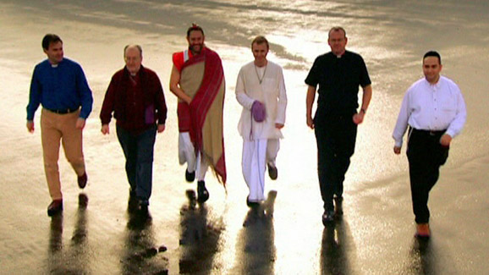
Religious Conflict
... occurs where two or more groups oppose one another because of their differing faiths or religious beliefs.

Slide 21
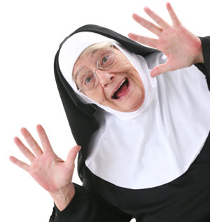
Religious Commitment
... pledge or promise to live as God asks; may involve taking on a new role.

Slide 22
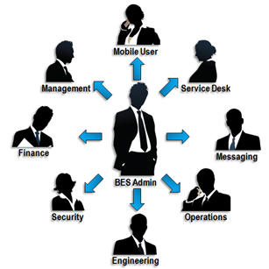
Roles
... specific tasks or functions within a group; jobs people do!

Slide 23
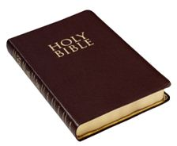
Sacred Text
... writings relating to a community of faith, which are considered holy or inspired.

Slide 24
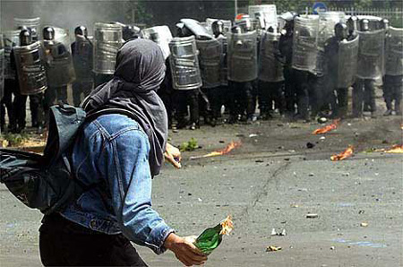
Secterianism
... excluding (even hating) others who do not belong to one’s own community of faith.

Slide 25
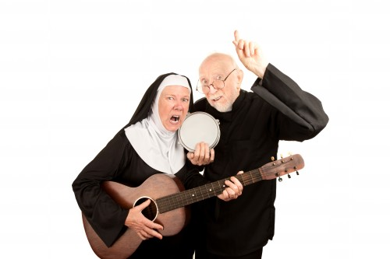
Service
... work done by a person or group for the good of another person or group.

Slide 26
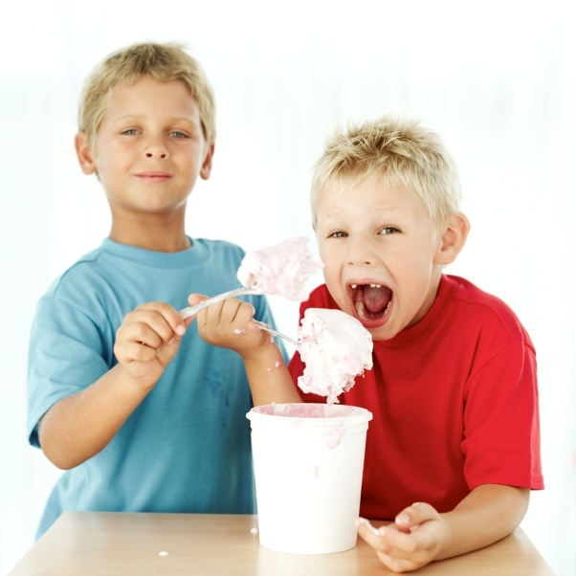
Sharing
... willing and unselfish giving to others.

Slide 27
Tolerance
... being willing to recognise and respect the beliefs and practices of others, while valuing and studying one’s own beliefs and practices.

Slide 28
Vision
... a powerful image of what the world or a person or a group could be.

Slide 29
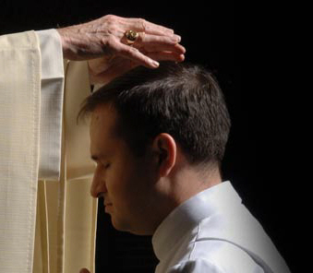
Vocation as a calling to Serve
... God calls people to carry out their roles/tasks in their communities of faith for the benefit of others.

