Slide 1
Salah -
The Muslim Prayer
Key words:
Salah
Wudu
Imam
Previous Lessons:
5 Pillars of Islam
Belief in Allah

Slide 2
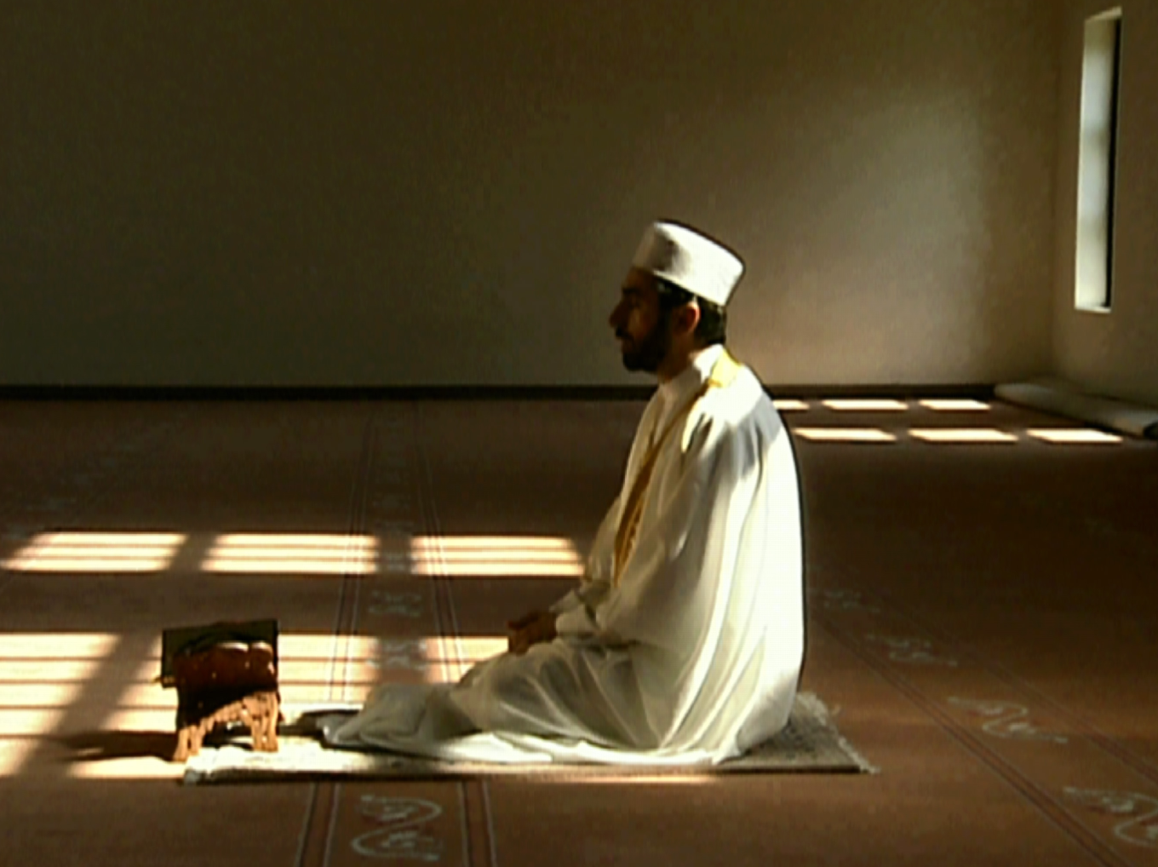
What is Salah?
Salah is the Arabic word for prayer. Salah involves both words and actions. This helps to focus the body and mind on Allah during prayers.

Slide 3
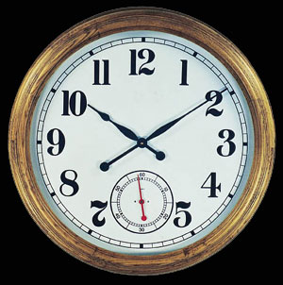
5 Daily Prayers
Muslims must pray 5 times a day. This is to keep remembering God throughout the day.
Muslims pray at different times of the day. These include:
early morning
Noon
mid-afternoon
Sunset
Night

Slide 4
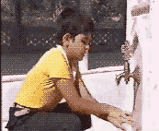
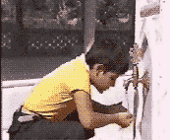
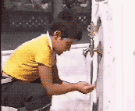
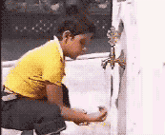
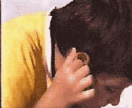
Wudu
Before Muslims can pray the must wash themselves. This is called wudu.
Muslims was their hands, face, arms and feet. They need to be physically clean to worship and pray to God.

Slide 5
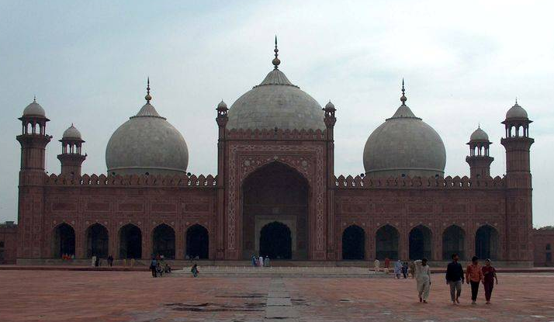
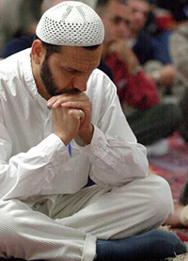
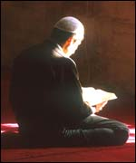
Muslims can pray at home or at the mosque.
Muslims believe it is better to pray at the Mosque along with other Muslims.

Slide 6
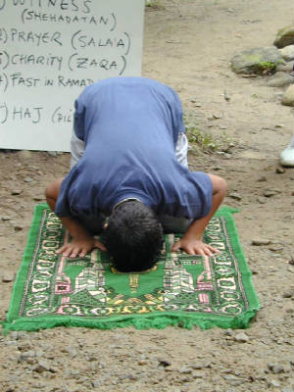
Prayer Mat
Before Muslims pray, the area they choose to pray must be clean. Often they use a prayer mat to pray on.

Slide 7
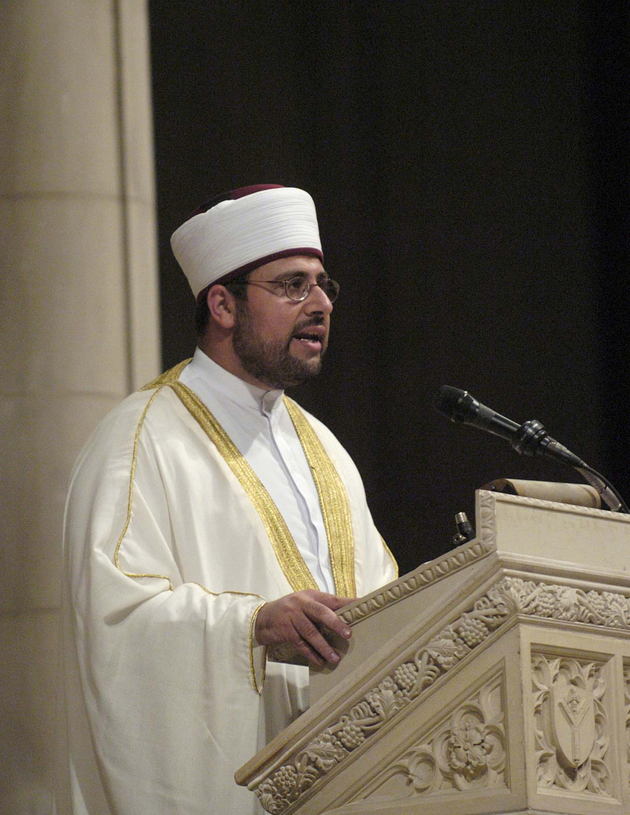
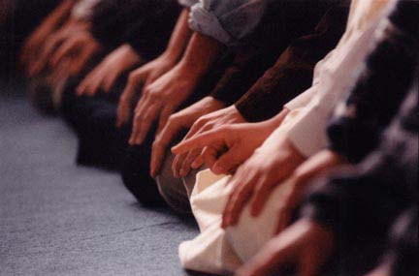
The Imam
At the Mosque, the Imam leads the prayers. Worshippers sit and stand close together – all facing Mecca. This is a sign of equality.

