Slide 1
How will a new Pope be elected?

Slide 2
Clergy
In the Christian church, the clergy is the entire class of religious officials, from priests to pastors to bishops and beyond.
Clergy is the word for all of the clerics combined, and is paired with the laity, which are all the people in the church who aren't in the clergy.

Slide 3
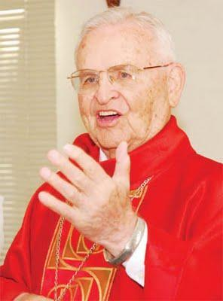
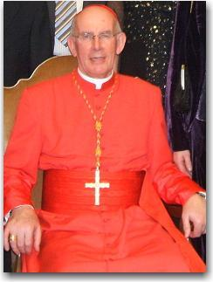
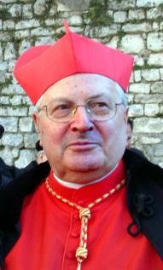
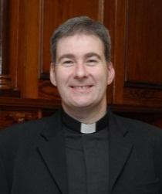
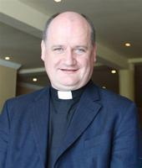
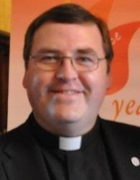
Who is in charge of the Catholic Church?
All of the Catholic priests

Slide 4
Cardinal
The word Cardinal means 'of prime importance'; 'chief'; 'principal'.
It is the second highest position in the Church and can only be confirmed by the Pope.
Also refers to the colour red - which is why the cardinals all wear red!

Slide 5
Pontificate
Pontificate comes from the French word pontiff, another word for the Pope, the leader of the Roman Catholic Church.
As a verb (pronounced pon-TIF-i-kate), it meant "to perform the functions of the Pope or other high official in the Church."

Slide 6
Conclave
A private or secret meeting is a conclave.
In Catholicism, a conclave is specifically a meeting of Roman Catholic cardinals who are locked in a room in seclusion when they need to choose a new pope. The word conclave comes from the Latin and originally meant "a locked room."

Slide 7
Conclave
The term is suitable since the cardinals are locked inside the Sistine Chapel in the Apostolic Palace during the voting process.
A conclave begins no earlier than 15 days and no later than 20 days after the pope's death.
Cardinals participating in conclave stay in St. Martha's House, a hospice inside the Vatican that has 130 rooms. Arrangements are made to ensure that the cardinals are not approached as they are transported between St. Martha's and the Sistine Chapel.

Slide 8
Cardinal Dean
The Cardinal Dean presides (rules) over the college of Cardinals

Slide 9
Rules of Election
The maximum number of electors from the College of Cardinals is 120. The college is currently composed of 194 cardinals.
Any cardinal who turns 80 before the day the Papacy is vacated, either by death or resignation, cannot take part in the election. Currently, 135 cardinals are eligible to vote under this rule (15 of those 135 would be disqualified from the vote because the limit is 120).

Slide 10
Rules of Election
A two-thirds-plus-one majority is required to elect a pope.
Two ballots each are held in the morning and afternoon, for a total of four per day.
If a new pope is not selected after 12 to 13 days, the cardinals may choose to impose a majority vote, which would allow selection of a new pope by a simple majority.

Slide 11
Rules of Election
Each rectangular ballot is inscribed at the top with the words Eligo in Summum Pontificem, meaning "I elect as supreme pontiff." Below these words, each cardinal writes down the name of the person he chooses as the pope. The vote is done in secret with paper and pen.
The voting cardinal then folds the ballot twice, holds it in the air, and carries it the chapel's altar. He then says, "I call as my witness Christ the Lord who will be my judge, that my vote is given to the one who before God I think should be elected."

Slide 12
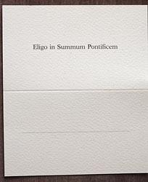
This is the voting slip used to elect a new Pope.
Each Cardinal will try to disguise their writing when they print the name of their choice.
They fold the card in half making it one inch wide.
The words on the top mean “I elect as supreme pontiff”.

Slide 13
Voting Procedure
Here are the steps for the vote-tallying procedure:
The first Scrutineer takes a ballot, notes the name on it, and passes it to the next Scrutineer.
The second Scrutineer notes the name and passes it to the third Scrutineer.
The third Scrutineer reads aloud the name on the ballot, pierces the ballot with a needle through the word Eligo at the top of the ballot, and slides the ballot onto a string of thread.
Each elector notes the name that is read.

Slide 14
Voting Procedure
Once all ballots are read, the Scrutineers write down the official count on a separate sheet of paper.
The third Scrutineer ties the ends of the thread on which the ballots are placed in a knot to preserve the vote.
The ballots are placed in a receptacle.
After each vote, the ballots and any notes regarding them are burned. Smoke from the burning of the ballots appears over the Vatican Palace. If no pope has been chosen, a chemical is applied to the ballots in order to create black smoke when burned. White smoke signals that a pope has been elected.

Slide 15
The New Pope
Once the new pope is elected, he meets with the Cardinal Deacon, the Secretary of the College of Cardinals, the Cardinal Dean, and the Master of Papal Liturgical Celebrations. The Cardinal Dean asks the elected pope two questions:
Do you accept your canonical election as Supreme Pontiff?
By what name do you wish to be called?

Slide 16
http://s3images.coroflot.com/user_files/individual_files/original_235391_Z1557u3SO2_sezE0xtMPZAHhp.jpg

Slide 17
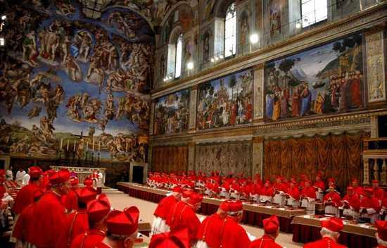
Electing a New Pope

Slide 18
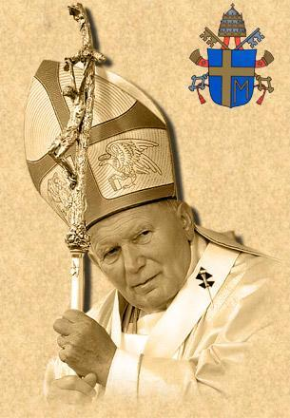
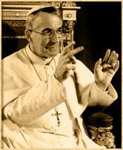
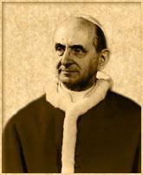
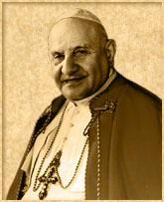
Who is the Pope?
The Pope is a central figure in World Religion. He is:
the leader of the Roman Catholic Faith across the world
the Bishop of Rome
the descendant of St. Peter
Who were the recent Popes?
John Paul II
John Paul I
Paul VI
John XXIII

Slide 19
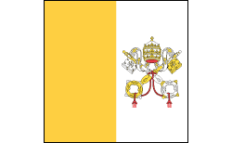
Where does the Pope live?
The Pope lives in the Vatican City in Rome. This is the smallest independent state in the World. Although it is in the Italian capital city of Rome, it is independent of Italy and the Pope has overall rule of this city.
Population: 836 approx
Size: 0.44 square kilometre
Currency: Euro
The flag of the Vatican City

Slide 20
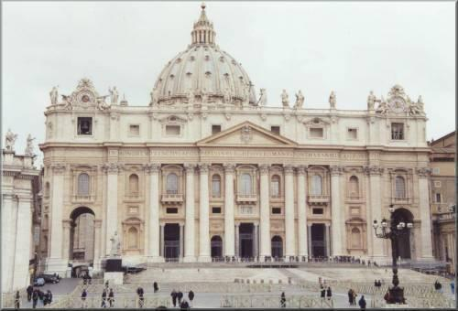

Slide 21
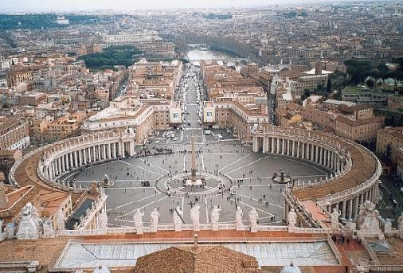

Slide 22
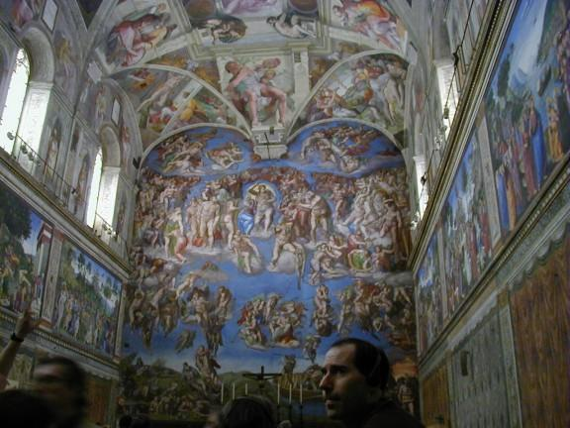

Slide 23
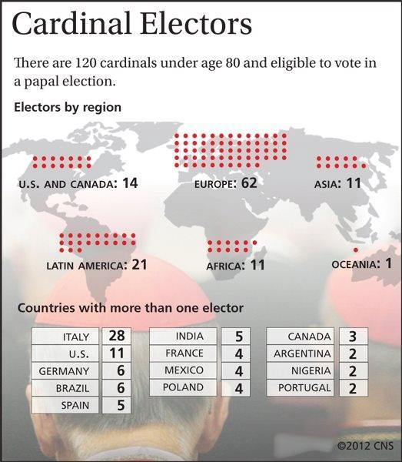

Slide 24
Electing a new Pope
To elect a new Pope, there are several stages.
All of the Cardinals of the Roman Catholic Church meet in Rome (unless they are over 80). There can be a maximum of 120 Cardinals involved in the vote.
The Cardinals all take part in a public mass to ask for guidance from the Holy Spirit.
The Senior Cardinal issues the order Extra Omnes and all not involved in the election process have to leave.
The doors are then sealed shut and the CONCLAVE starts.

Slide 25
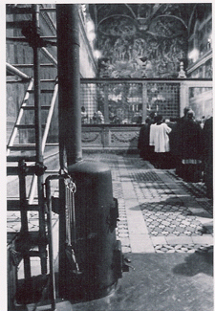
All votes cast in the election are secret and must be destroyed immediately.
They are burnt in the small stove that is located in the Sistine chapel.
The colour of the smoke that comes from the chimney is what people watch for.

Slide 26
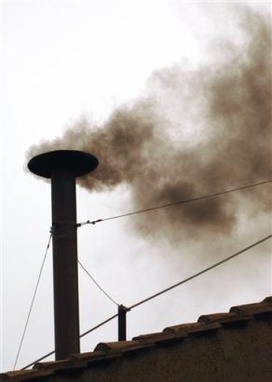
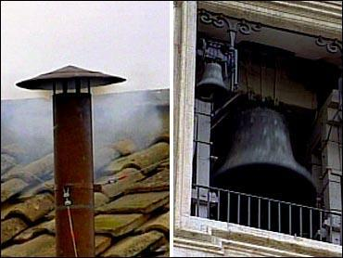
If the smoke from the chimney is white, a new Pope has been elected. The great bells of St. Peter will also ring.
If the smoke from the chimney is black, another vote is needed.

Slide 27
How It All Happens...
http://vaticaninsider.lastampa.it/en/the-vatican/come-si-elegge-il-papa/

Slide 28
Interactive Quiz
http://www.funtrivia.com/newflash/trivia.cfm?qid=50185

