Slide 1
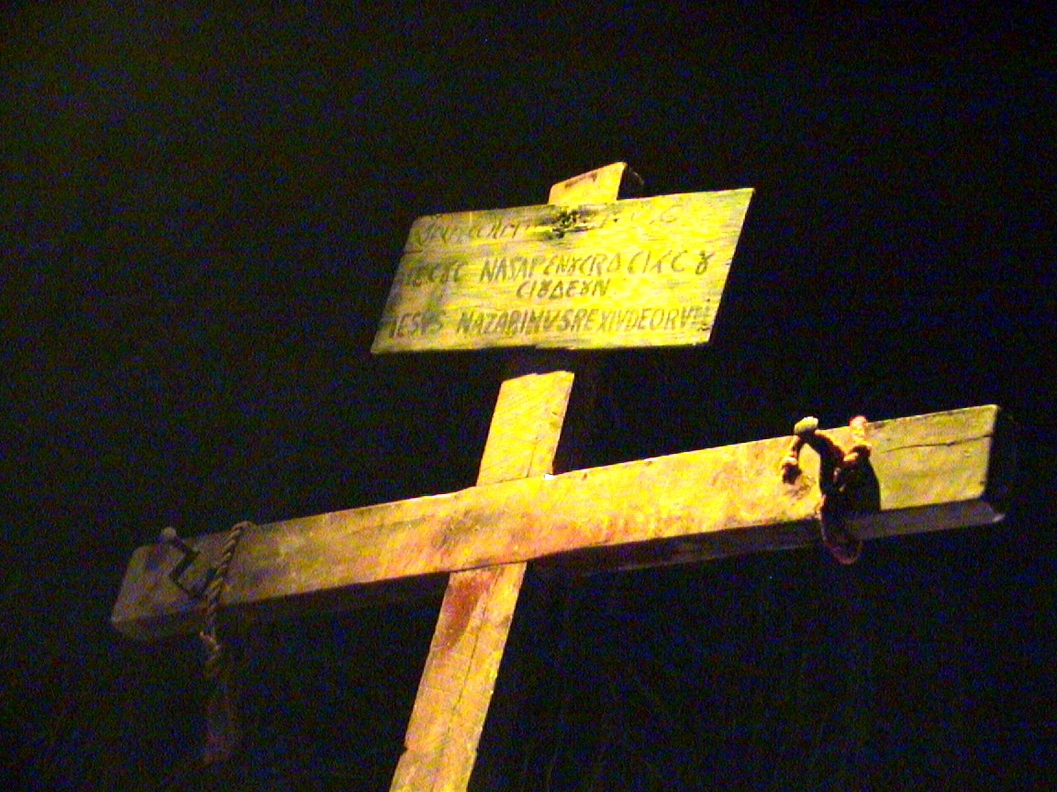

Slide 2
Opening Hymn…
Jesus, keep me near the cross,
There a precious fountain,
Free to all a healing stream,
Flows from Calvary’s mountain.
Near the cross a trembling soul,
Love and mercy found me;
There the Bright and Morning Star
Shed its beams around me.
Near the cross! O, Lamb of God,
Bring its scenes before me;
Help me walk from day to day,
With its shadow o’er me.
In the Cross, in the cross, be my glory forever,
Till my raptured soul shall find rest beyond the river.

Slide 3
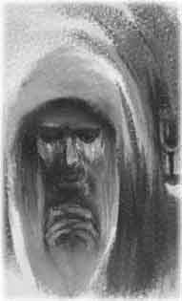
The Prayer of Jesus in the Garden…
“Sit here while I pray…” Mark 14:32

Slide 4
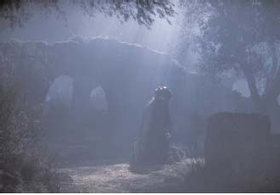
The Prayer of Jesus in the Garden…
“Sit here while I pray…” Mark 14:32

Slide 5
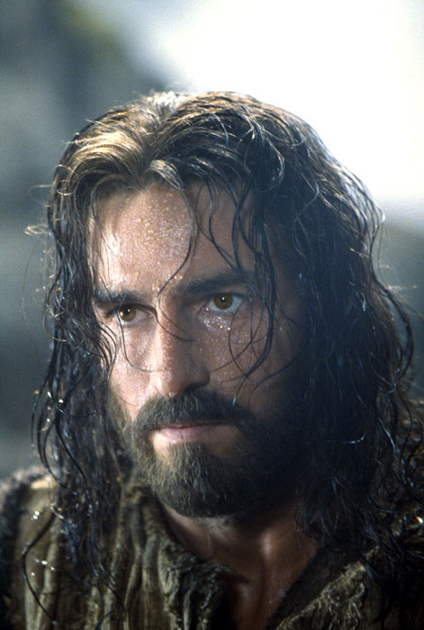
The Prayer of Jesus in the Garden…
“Sit here while I pray…” Mark 14:32

Slide 6
The Prayer of Jesus in the Garden…
…Lord our God,
In his agony in the garden,
Jesus, your Son, taught us by word and example
How to pray in time of trial.
Keep us always faithful to prayer,
That we may reap its rich harvest of grace.

Slide 7
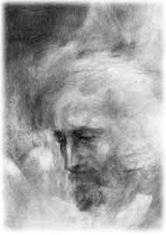
Jesus is Condemned to Death…
“Then Pilate handed Jesus over to them
to be crucified.” John 19:16

Slide 8
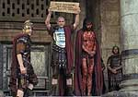
Jesus is Condemned to Death…
“Then Pilate handed Jesus over to them
to be crucified.” John 19:16

Slide 9
Jesus is Condemned to Death…
Eternal Father,
You looked kindly on your only Son
When he was derided and condemned to death.
Through His patience in suffering,
Heal our pride.
Keep us from judging others
That we may be shown mercy on judgement day.

Slide 10
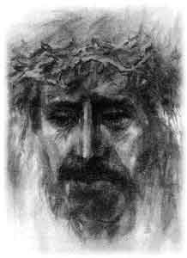
Jesus is Crowned with Thorns…
“Hail, King of the Jews!” Mark 15: 16-19

Slide 11
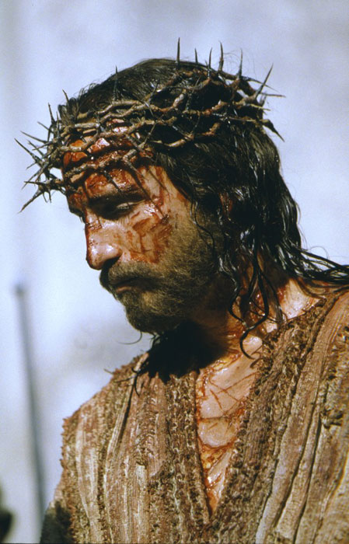
Jesus is Crowned with Thorns…
“Hail, King of the Jews!” Mark 15: 16-19

Slide 12
Jesus is Crowned with Thorns…
…Lord Our God,
For love of us, your beloved Son
Accepted a crown of thorns
And stood silent in the midst of insults.
Teach us to recognise the face of Christ
In all who suffer in mind and body.
Give us strength to help them
That we may grow daily in your love.

Slide 13
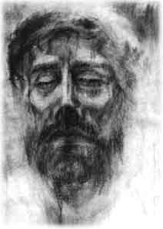
The Face of the Suffering Christ…
Pilate said to the Jews “Look at the man…”

Slide 14
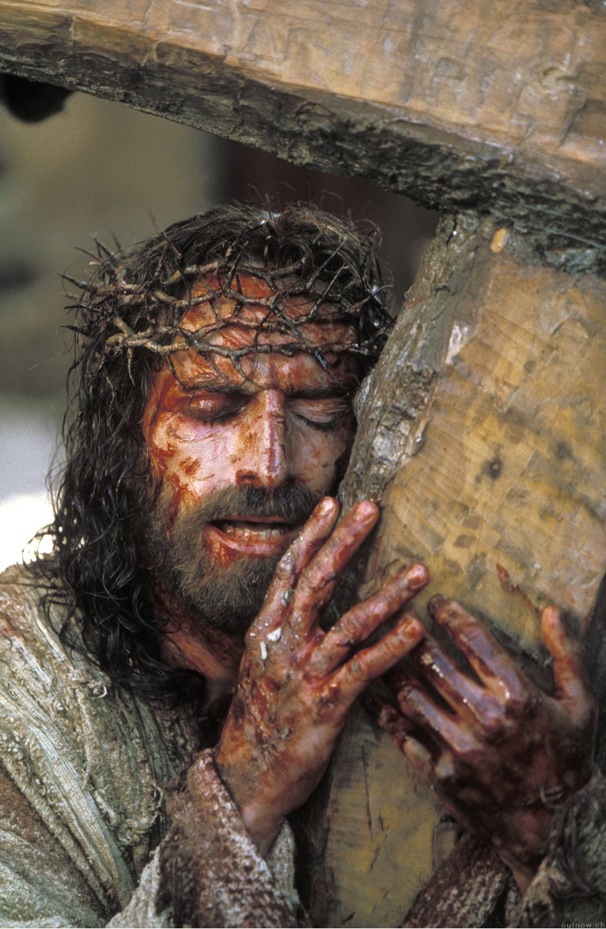
The Face of the Suffering Christ…
Pilate said to the Jews “Look at the man…”

Slide 15
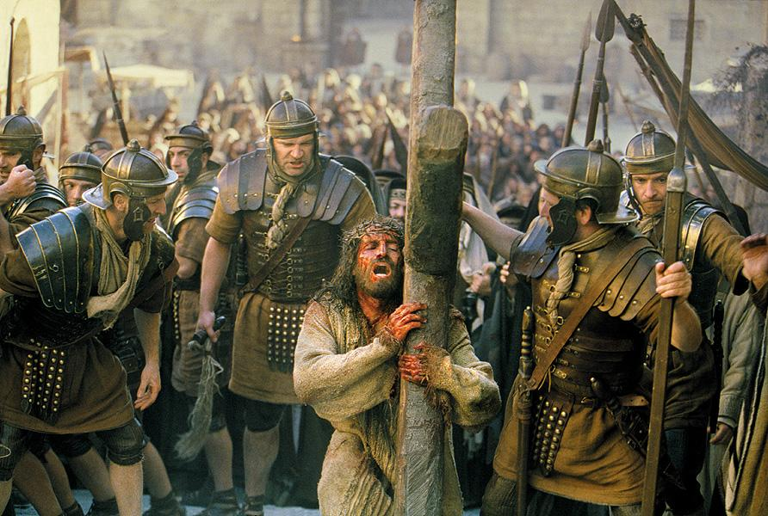
The Face of the Suffering Christ…
Pilate said to the Jews “Look at the man…”

Slide 16
The Face of the Suffering Christ…
…Lord our God,
Through the passion of your only Son,
You have freed us from our inheritance of sin and death.
Destroy in us our failure to look beyond ourselves
So that we may see the face of Christ in those
who experience suffering around us.

Slide 17
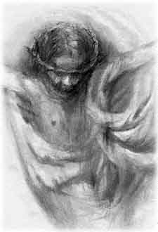
The Crucifixion & Death of Jesus…
Christ said, “I love you this much…” and he stretched out his arms and he died for us.

Slide 18
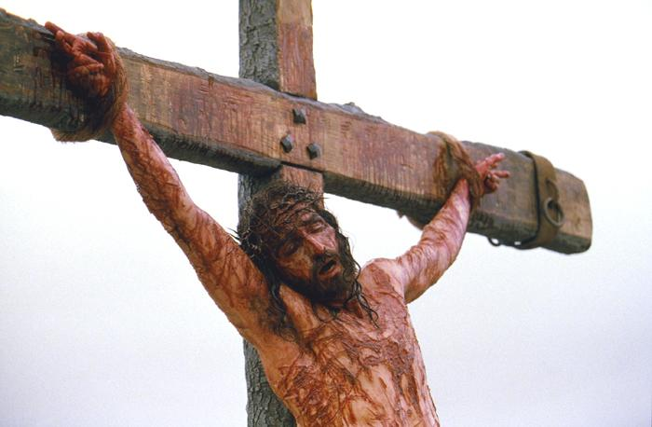
The Crucifixion & Death of Jesus…
Christ said, “I love you this much…” and he stretched out his arms and he died for us.

Slide 19
The Crucifixion & Death of Jesus…
Christ said, “I love you this much…” and he stretched out his arms and he died for us.

Slide 20
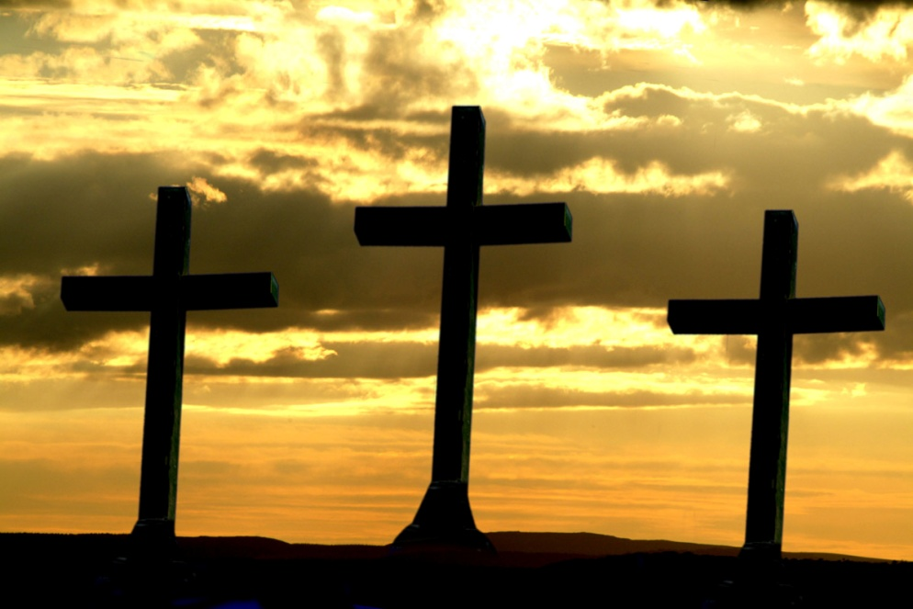
Be Still , For The Presence Of The Lord
Be still for the presence of the Lord, the Holy One is here.
Come, bow before Him now, with reverence and fear.
In Him no sin is found. We stand on holy ground
Be still for the presence of the Lord, the Holy One is here.

Slide 21
Be Still , For The Presence Of The Lord
Be still for the glory of the Lord, is shining all around:
He burns with holy fire, with splendour he is crowned.
How awesome is the sight, our radiant King of Light!
Be still for the glory of the Lord is shining all around

Slide 22
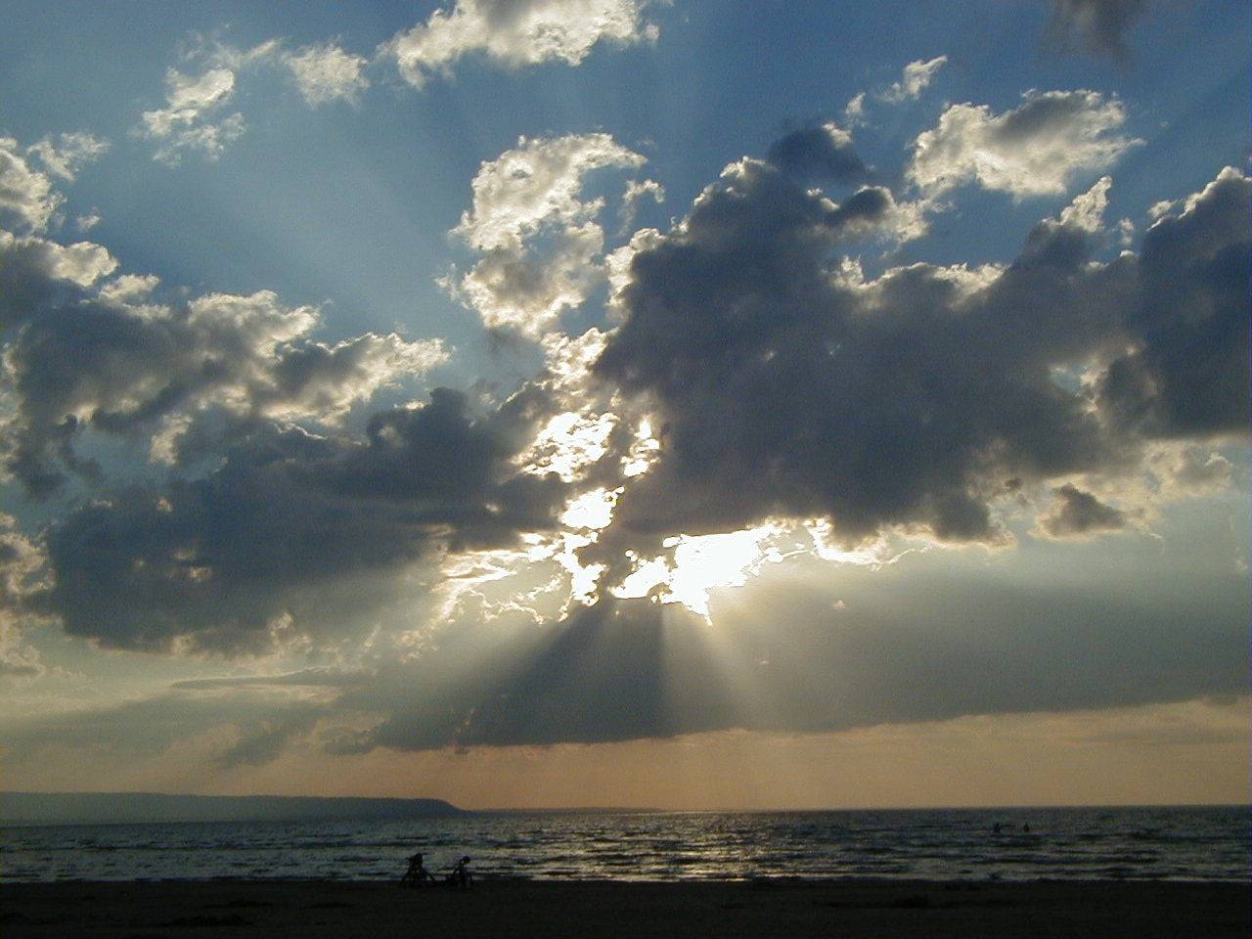
Be Still , For The Presence Of The Lord
Be still for the power of the Lord, is moving in this place:
He comes to cleanse and heal to minister his grace.
No work to hard for Him: in faith receive from him.
Be still for the power of the Lord is moving in this place.

Slide 23
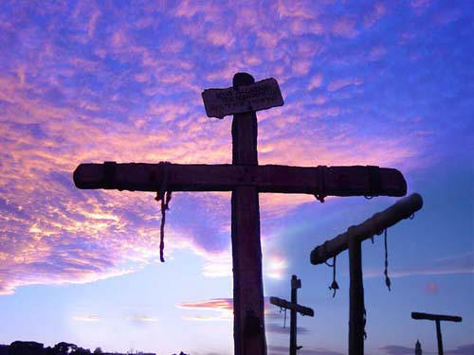
The Crucifixion & Death of Jesus…
Good Friday
Christ said, “I love you this much…” and he stretched out his arms and he died for us.

Slide 24
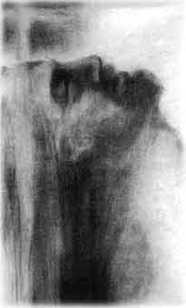
Jesus Rises In Glory From The Tomb
Alleluia! Alleluia!

Slide 25
Jesus Rises In Glory From The Tomb
Alleluia! Alleluia!

Slide 26
Jesus Rises In Glory From The Tomb
Alleluia! Alleluia!

Slide 27
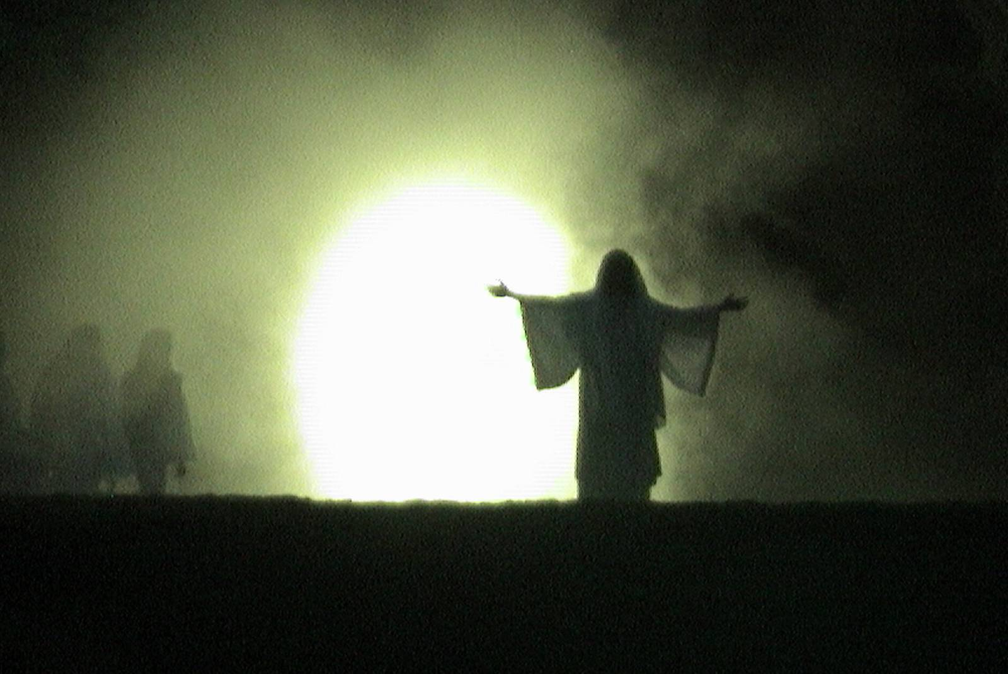
Jesus Rises In Glory From The Tomb
Easter Sunday
Alleluia! Alleluia!

Slide 28
Jesus Is Risen From The Dead
Lord Jesus,
Out of love for us,
You died and rose again on the third day.
Grant us a share in your victory over death
And in the glory of your resurrection,
As you live and reign with the Father
And the Holy Spirit, one God for ever and ever,
Alleluia! Alleluia!

Slide 29
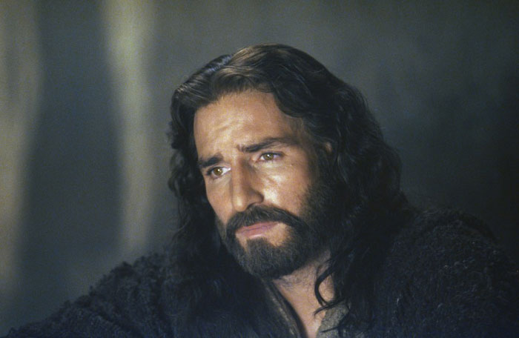
Love One Another…
…As I Have Loved You.

